Slide 1
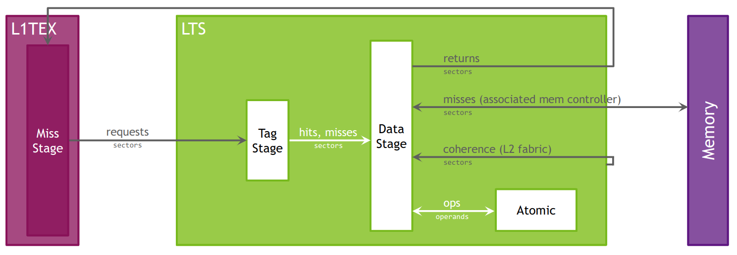
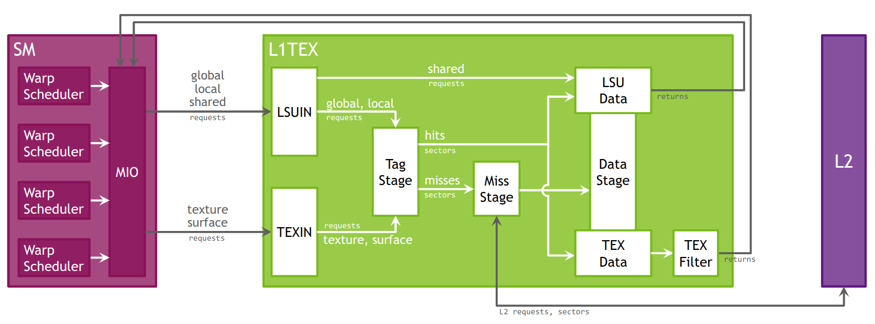
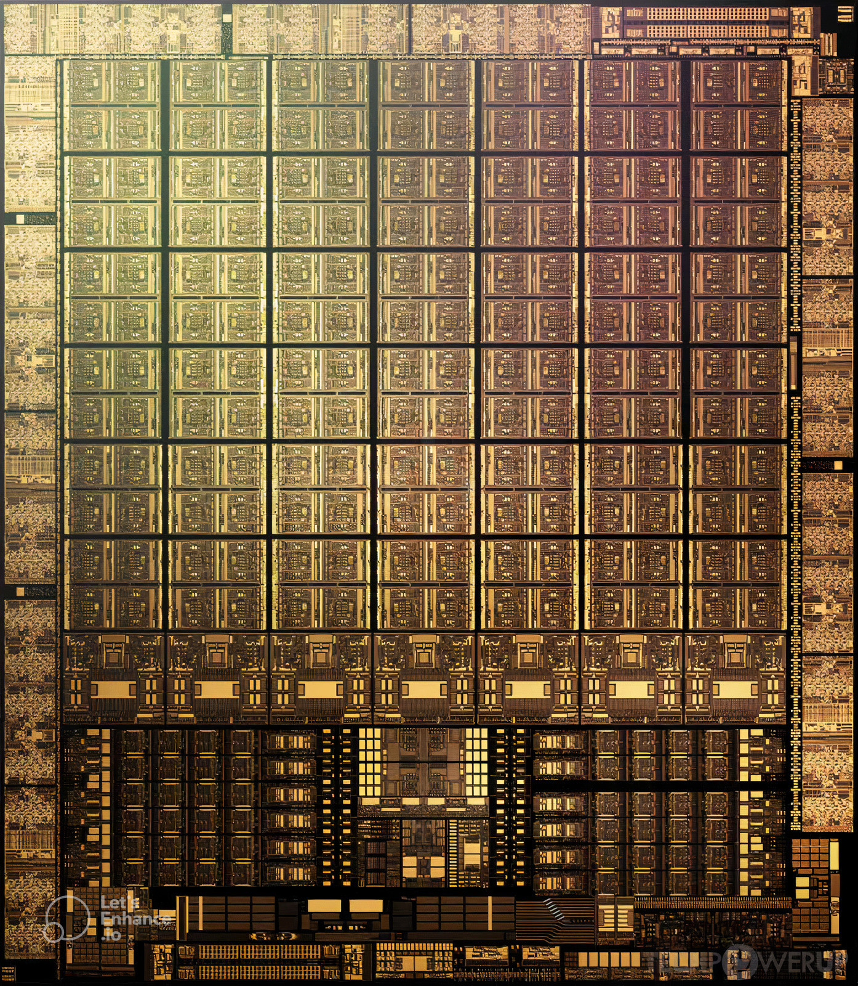
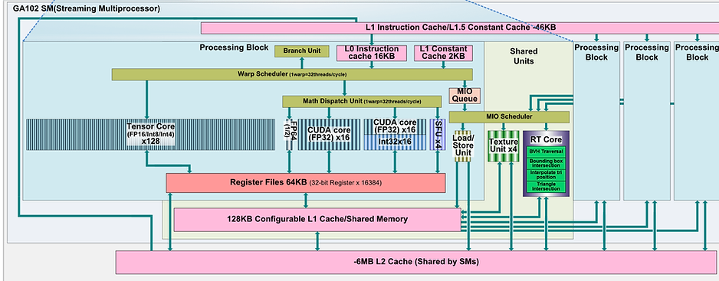
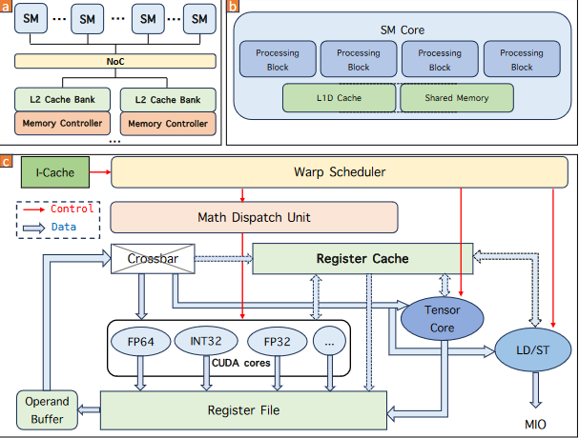
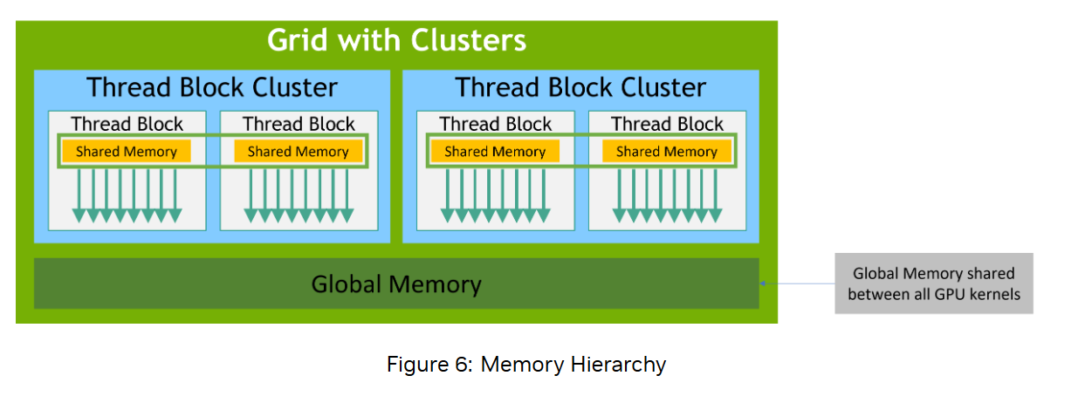
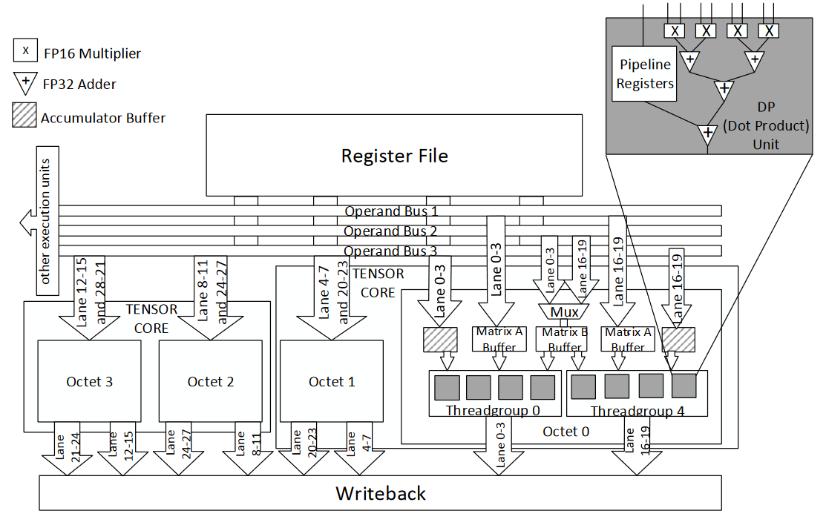




L1 Instruction Cache
Branch Unit
L0 Instruction Cache
Warp Scheduler
CUDA
Core
MD unit
SFU
CUDA
Core
LSU
SFU
LSU
ALU
SFU
LSU
Tensovr Core
Math Dispatch Unit
SFU
LSU
MUFU/XU/SFU Instruction
queue
LSU (FIFO) Instruction Queue
The memory subsystems contains L1, TEX unit, shared memory unit, and other domain specific (e.g. graphics) interfaces to the SM
CUDA
Core
CUDA
Core
CUDA
Core
CUDA
Core
fp32
fp32
fp32
fp32
int32
int32
L1 imm
CUDA
Core
CUDA
Core
CUDA
Core
CUDA
Core
MIO Scheduler
Tensor
Warp Scheduler
Tensor
CUDA
Core
fp32
fp32
fp32
fp32
All short scoreboards
All Variable latency
CUDA
Core
int32
int32
ALU
MD unit
MD unit
ALU
L1 idx
CUDA
Core
CUDA
Core
CUDA
Core
CUDA
Core
What is MIO instruction queue?
Direct dispatch?
fp32
fp32
fp32
fp32
ADU
fp64
Operand buffer+Register Cache
int32
int32
pipelined
SFU
SFU
LSU
LSU
executes global/local/shared loads/store/atomics and several warp level operations (e.g. VOTE, SHUFFLE).
CUDA
Core
CUDA
Core
CUDA
Core
CUDA
Core
2*L0 I Cache
LSU
LSU
LSU
LSU
fp32
fp32
fp32
fp32
SFU
SFU
LSU
LSU
Misc.
Units
Address Divergence Unit
Memory Convergence Unit
Tensor Access Unit
etc.
int32
int32
MIO Scheduler
SFU
SFU
Crossbar
CUDA
Core
CUDA
Core
CUDA
Core
CUDA
Core
fp32
fp32
fp32
fp32
SFU
SFU
int32
int32
L1 ICache
CUDA
Core
CUDA
Core
CUDA
Core
L1 Immediate Constant Cache 2 KB
2*64 KB Register File
fp32
CUDA
Core
SFU
SFU
fp32
fp32
fp32
MUFU/XU/SFU Instruction
queue
int32
int32
L2 Cache
LSU (FIFO) Instruction Queue
SFU
SFU
L1D
CUDA
Core
CUDA
Core
CUDA
Core
CUDA
Core
L1 InDexed Constant Cache 8 KB
fp32
fp32
fp32
fp32
int32
int32
LSU
LSU
LSU
LSU
L1 Dcache/Smem 128kb (LUSIN)
CUDA
Core
CUDA
Core
CUDA
Core
CUDA
Core
Operand buffer
fp32
fp32
fp32
fp32
LSUIN
LSU
Instruction Decoder
Operand buffer+Register Cache
int32
int32
CUDA
Core
ALU
MD unit
MD unit
ALU
CUDA
Core
Register Cache
ALU
Warp Scheduler
Tag
Miss
Data
Tensor
Tensor
64 KB Register File
Operand Buffer
Math Dispatch Unitv
Warp Scheduler
Branch Unit
LSU
Branch Unit
L1 idxCache
L1 immCache
Crossbar
L0 ICache
Tensor Core
L1 ICache
Crossbar
L1 DCache
Warp Scheduler
Register File
Branch Unit
Int/fp16 cores
Register Cache
Fp16 cores
Warp Schduler
SFU
ALU
SFU
128 KB
Judging by greg this is probably correct
L1 Instruction Cache
L1.5 InDexed Constant Cache 8 KB
Branch Unit
L0 Instruction Cache
Warp Scheduler
Tensor Core
Math Dispatch Unit
MIO
Block
CUDA
Core
CUDA
Core
CUDA
Core
CUDA
Core
MUFU Instruction
queue
LSU Queue
fp32
fp32
fp32
fp32
int32
int32
MIO Scheduler
CUDA
Core
CUDA
Core
CUDA
Core
CUDA
Core
fp64
Mio block shared between all subprocessors
fp32
fp32
fp32
fp32
Emulated
Does not
exist
int32
int32
SFU
SFU
LSU
LSU
SFU
SFU
LSU
LSU
CUDA
Core
CUDA
Core
CUDA
Core
CUDA
Core
fp32
fp32
fp32
fp32
Lsu pipeline
int32
int32
CUDA
Core
CUDA
Core
CUDA
Core
CUDA
Core
fp32
fp32
fp32
fp32
int32
int32
Crossbar
CUDA
Core
CUDA
Core
CUDA
Core
CUDA
Core
Mio datapath
fp32
fp32
fp32
fp32
int32
int32
CUDA
Core
CUDA
Core
CUDA
Core
CUDA
Core
fp32
fp32
fp32
fp32
int32
int32
CUDA
Core
CUDA
Core
CUDA
Core
CUDA
Core
fp32
fp32
fp32
fp32
int32
int32
ADU
CUDA
Core
CUDA
Core
CUDA
Core
CUDA
Core
Operand buffer
fp32
fp32
fp32
fp32
int32
int32
Register Cache
ALU
64 KB Register File
L1 Dcache/Smem 128kb (MIO)
Notes:
Right so I need to, first figure out how to integrate the indexed constant cache and ADU into the system
What’s difference between indexed constant cache and Immediate Constant Cache
Mio block is guaranteed to request from indexed constant cache, but how.
Lsu unit is located in
mio_throttle (ADU, CBU, LSU, XU)
lg_throttle (LSU)
lg_throttle is used if MIO instruction queue reaches a watermark for local/global instructions. Throttling local/global instructions early allows SM to continue to issue shared memory instructions when L1 backpressure due to local/global L1 misses.
L1Tex partition may refer to more than the texture cache: LSU interface is for shared memory, local/global memory (tagged), and special operations such as shuffle and special purpose registers.
Hi there! Our 768 instructions are split into 6 blocks of 4 warps, each warp containing 32 threads. Each warp’s threads are executed for an allocated timeslot, before moving to the next warp. This is known as Round Robin Scheduling.

Slide 2
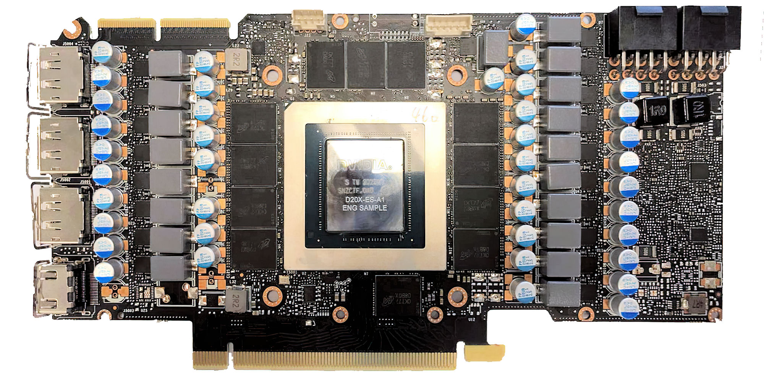
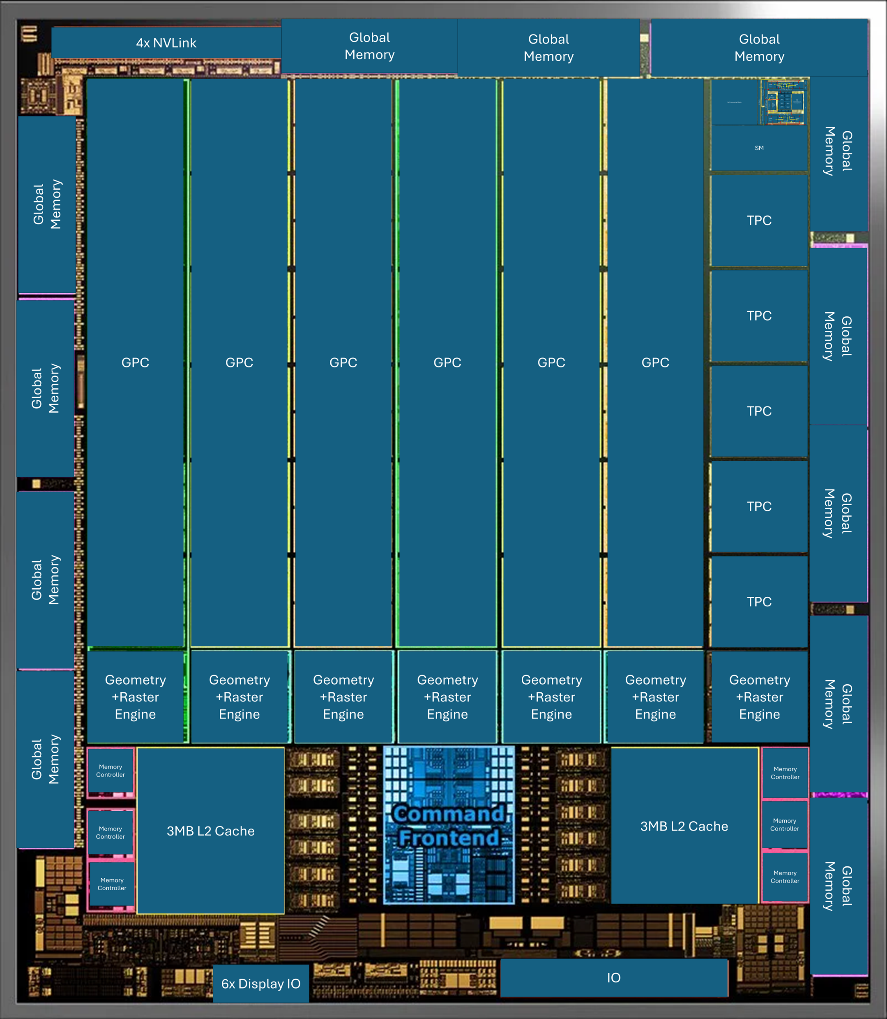
reflection
shadow
shiny
Color
reflection
shadow
shiny
Color
reflection
shadow
shiny
Color
Notes:
A block’s first instructions are sent for processing before moving on to subsequent blocks, a strategy known as Round Robin Scheduling which is carried out by the Warp Scheduler.

Slide 3
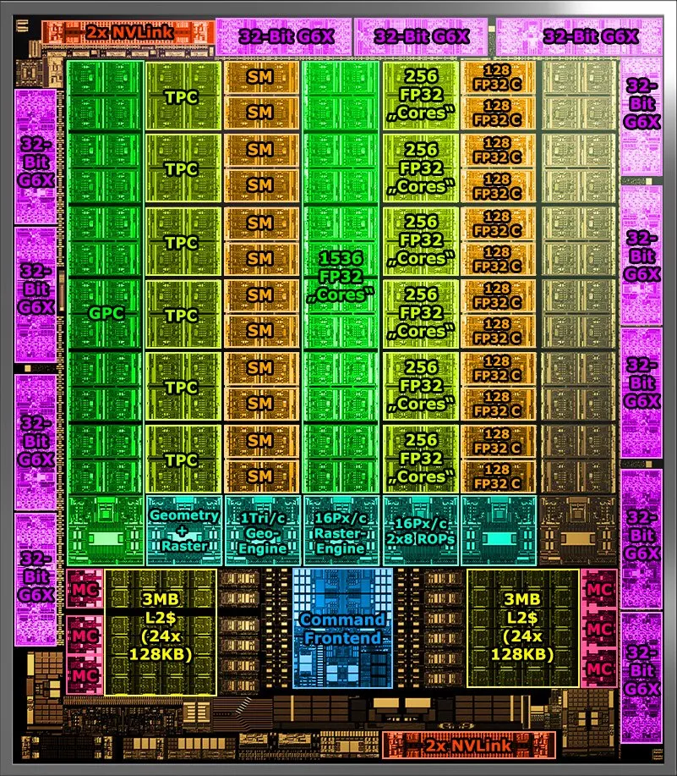
Global
Memory
Global
Memory
Global
Memory
4x NVLink
GPC
GPC
GPC
GPC
GPC
GPC
2x Processing Block
CUDA
Core
Tensor
Warp Scheduler
Tensor
CUDA
Core
L1 imm
ALU
MD unit
MD unit
ALU
L1 idx
Operand buffer+Register Cache
2*L0 I Cache
LSU
LSU
LSU
LSU
MIO Scheduler
SFU
SFU
Misc.
Units
Address Divergence Unit
Memory Convergence Unit
Tensor Access Unit
etc.
SFU
SFU
L1 ICache
2*64 KB Register File
MUFU/XU/SFU Instruction
queue
SFU
SFU
LSU (FIFO) Instruction Queue
SFU
SFU
L1D
LSU
LSU
LSU
LSU
Instruction Decoder
Operand buffer+Register Cache
CUDA
Core
ALU
MD unit
MD unit
ALU
CUDA
Core
Tensor
Warp Scheduler
Tensor
Global
Memory
SM
Global
Memory
TPC
TPC
Global
Memory
Global
Memory
TPC
TPC
Global
Memory
Global
Memory
TPC
Geometry
+Raster
Engine
Geometry
+Raster
Engine
Geometry
+Raster
Engine
Geometry
+Raster
Engine
Geometry
+Raster
Engine
Geometry
+Raster
Engine
Geometry
+Raster
Engine
Global
Memory
Global
Memory
Memory Controller
3MB L2 Cache
3MB L2 Cache
Memory Controller
Memory Controller
Memory Controller
Memory Controller
Global
Memory
Memory Controller
IO
6x Display IO
Notes:
Instructions may be stored on the L1 or L0 instruction cache, memory units local to the SM for faster retrieval.

Slide 4
2x Processing Block
L1 imm
CUDA
Core
Tensor
Warp Scheduler
Tensor
CUDA
Core
ALU
MD unit
MD unit
ALU
L1 idx
Operand buffer+Register Cache
2*L0 I Cache
LSU
LSU
LSU
LSU
MIO Scheduler
SFU
SFU
Misc.
Units
Address Divergence Unit
Memory Convergence Unit
Tensor Access Unit
etc.
SFU
SFU
L1 ICache
2*64 KB Register File
MUFU/XU/SFU Instruction
queue
SFU
SFU
LSU (FIFO) Instruction Queue
SFU
SFU
L1D
LSU
LSU
LSU
LSU
Instruction Decoder
Operand buffer+Register Cache
CUDA
Core
ALU
MD unit
MD unit
ALU
CUDA
Core
Tensor
Warp Scheduler
Tensor
Instruction Line
Data Line
Multi Line
Notes:
Instructions may be stored on the L1 or L0 instruction cache, memory units local to the SM for faster retrieval.

Slide 5
CUDA
Core
CUDA
Core
CUDA
Core
CUDA
Core
fp32
fp32
fp32
fp32
int32
int32
CUDA
Core
CUDA
Core
CUDA
Core
CUDA
Core
fp32
fp32
fp32
fp32
int32
int32
CUDA
Core
CUDA
Core
CUDA
Core
CUDA
Core
fp32
fp32
fp32
fp32
int32
int32
CUDA
Core
CUDA
Core
CUDA
Core
CUDA
Core
fp32
fp32
fp32
fp32
int32
int32
CUDA
Core
CUDA
Core
CUDA
Core
CUDA
Core
fp32
fp32
fp32
fp32
int32
int32
CUDA
Core
CUDA
Core
CUDA
Core
CUDA
Core
fp32
fp32
fp32
fp32
int32
int32
CUDA
Core
CUDA
Core
CUDA
Core
CUDA
Core
fp32
fp32
fp32
fp32
int32
int32
CUDA
Core
CUDA
Core
CUDA
Core
CUDA
Core
fp32
fp32
fp32
fp32
int32
int32
Notes:
Instructions may be stored on the L1 or L0 instruction cache, memory units local to the SM for faster retrieval.

Slide 6
Notes:
Instructions may be stored on the L1 or L0 instruction cache, memory units local to the SM for faster retrieval.

Slide 7
Draw me a pixel
Color
Draw me a pixel
reflection
Draw me a pixel
shadow
Draw me a pixel
shiny
Notes:
Tasks are serialized into GPU-native instructions

Slide 8
Color
reflection
shadow
shiny
Notes:
and organized into blocks of 32 tasks

Slide 9
instruction
instruction
instruction
instruction
instruction
instruction
instruction
instruction
instruction
instruction
instruction
instruction
Notes:
, and assigned across multiple GPU sub-processors, known as Streaming Multiprocessors.

Slide 10
instruction
instruction
instruction
instruction
instruction
instruction
instruction
instruction
instruction
instruction
instruction
instruction
Notes:
Instructions may be stored on the L1 or L0 instruction cache, memory units local to the SM for faster retrieval.

Slide 11
Processor looking thing here
reflection
shadow
shiny
Color
reflection
shadow
shiny
Color
reflection
shadow
shiny
Color
Notes:
A block’s first instructions are sent for processing before moving on to subsequent blocks, a strategy known as Round Robin Scheduling which is carried out by the Warp Scheduler.

Slide 12
Processor looking thing here
reflection
shadow
shiny
Color
reflection
shadow
shiny
Color
reflection
shadow
shiny
Color
Notes:
The instructions to be processed arrive at the Math Dispatch Unit, which delegates instructions to specialized computation units, which process different types of arithmetic and memory operations

Slide 13
Processor looking thing here
reflection
shadow
shiny
Color
reflection
shadow
shiny
Color
reflection
shadow
shiny
Color
Notes:
Execution of arithmetic operations typically takes many hundreds of clock cycles. However, we can take advantage of the same tasks being executed repeatedly by leveraging the concept of pipelining

Slide 14
Processor looking thing here
reflection
shadow
shiny
Color
reflection
shadow
shiny
Color
reflection
shadow
shiny
Color
Notes:
Execution of arithmetic operations typically takes many hundreds of clock cycles. However, we can take advantage of the same tasks being executed repeatedly by leveraging the concept of pipelining

Slide 15
Processor looking thing here
reflection
shadow
shiny
Color
reflection
shadow
shiny
Color
reflection
shadow
shiny
Color
Notes:
Execution of a calculation goes through multiple different circuits, leaving circuits that are not immediately participating in a calculation inactive

Slide 16
Processor looking thing here
reflection
shadow
shiny
Color
reflection
shadow
shiny
Color
reflection
shadow
shiny
Color
Notes:
We can fill this inactivity by following up with a second calculation, turning our few hundred clock cycle execution into effectively a 1 clock cycle execution time on average

Slide 17
Processor looking thing here
reflection
shadow
shiny
Color
reflection
shadow
shiny
Color
reflection
shadow
shiny
Color
Notes:
Arithmetic that will take longer will often be prioritized, to overlap operations and maximize use of pipeline stages.

Slide 18
Processor looking thing here
reflection
shadow
shiny
Color
reflection
shadow
shiny
Color
reflection
shadow
shiny
Color
Notes:
First, we need our operands. Memory operations are queued to the Load Store Unit (LSU), which resolves memory locations for requested data, and sends lookup requests to memory units outside the SM.

Slide 19
Processor looking thing here
reflection
shadow
shiny
Color
reflection
shadow
shiny
Color
reflection
shadow
shiny
Color
Notes:
The LSU then stores our requested operands in the register file

Slide 20
Processor looking thing here
reflection
shadow
shiny
Color
reflection
shadow
shiny
Color
reflection
shadow
shiny
Color
Notes:
Since fetching data can be slow, we can continue execution while we wait for our data

Slide 21
Processor looking thing here
reflection
shadow
shiny
Color
reflection
shadow
shiny
Color
reflection
shadow
shiny
Color
Notes:
Our retrieved data can also be stored in caches. We have caches for constant values, arrays and register values among others.

Slide 22
Processor looking thing here
reflection
shadow
shiny
Color
reflection
shadow
shiny
Color
reflection
shadow
shiny
Color
Notes:
Our retrieved data can also be stored in caches. We have caches for constant values, arrays and register values among others.

Slide 23
Processor looking thing here
reflection
shadow
shiny
Color
reflection
shadow
shiny
Color
reflection
shadow
shiny
Color
Notes:
Now, to compute. GPU arithmetic units are split into two sections. One being fast units, which take a set number of clock cycles to execute, and slow units, which take a variable number of clock cycles.

Slide 24
Processor looking thing here
reflection
shadow
shiny
Color
reflection
shadow
shiny
Color
reflection
shadow
shiny
Color
Notes:
Some example of fast units are those for floating point and integer operations, while examples of slow units are the transcendental unit, which calculates trigonometric and root functions, or the double precision unit, which handles 64 bit floating point operations.

Slide 25
Processor looking thing here
reflection
shadow
shiny
Color
reflection
shadow
shiny
Color
reflection
shadow
shiny
Color
Notes:
There also exists an Arithmetic Logic Unit for bitwise operations and half precision floating point conversion.

Slide 26
Processor looking thing here
reflection
shadow
shiny
Color
reflection
shadow
shiny
Color
reflection
shadow
shiny
Color
Notes:
In recent years, GPUs have included arithmetic units for matrix operations, called the tensor core. Explaining per octet, starting with octet 0, there are 3 operand buses, since ptx supports up to 3 operands in an instruction. There is also a connection to the register file associated with the streaming multiprocessor. operand bus 2 is sent to a multiplexer, and used as control signals to indicate which operation should be executed by the tensor core. Operand Bus 1 is sent to the matrix buffers, while operand bus 3 is sent to an accumulator. Registers can also be used to add to the matrix optionally. In each tensor core there are 2 octets, making 16 dot product units.

Slide 27
Processor looking thing here
reflection
shadow
shiny
Color
reflection
shadow
shiny
Color
reflection
shadow
shiny
Color
Notes:
Finally, we have the crossbar, which facilities communication between caches and computation units across the SM. Once our computation is complete, it is dispatched across multiple data buses to an IO port, where it is sent to the rest of the system.

Slide 28
Here begins my ted talk research adventure
premise-driven narrative
Pitfalls
THE SALES PITCH
THE RAMBLE
THE ORG BORE: Applying here, do not talk about your boring research process, focus on the exciting science
That means no lazy screenshots of ghidra, future you
THE INSPIRATION PERFORMANCE: Do not appeal to audience TOO much
Talk Must say something meaningful. Now, if someone were to ask me why they should listen to my talk on
Cuda and gpus. What would I say?
I’d say that you KNOW how fast computers are, but you’ve never thought about how you CAN learn from them.
They aren’t just fast, they’re also likely more efficient than you, and you’ll learn why by watching my TED talk.
I’m tasking you now to recite the first sentence of your TED Talk. If the audience listening doesn’t like it, they’re gonna exit the theater, leaving you to stew in your irrelevancy, What are you gonna say?
Alright. You’re talking about the CUDA architecture. That’s cool and all, but even you’re struggling to comprehend these ginormous manuals, and you expect an audience to understand the big picture of CUDA in 5 minutes? Haha. Well, sorry to let you know, you’re in front of a LIVE audience now, and they have shotguns and WILL shoot you the moment they get confused. Talk to them now, and you best choose a concept that you can explain within 5 minutes.
Looks like there some similarity to narrative structures here huh. Think stanley parable adventure line. Right, now I suppose you’re gonna have to take users through a journey of CUDAland, so you better “design me a map”. Oh and you’re tied to a pillar over a shark pond or something.
Tied back to an earlier question. Better to fully flesh out a topic than cover a wide variety of scaled back content. To use the story metaphor, you gotta write a story, not an anthology.
The hero can’t just inexplicably teleport to another location mid story.
The hero should undergo the hero’s journey. You can shake this up a bit, but it must make sense within the context of the story.
Oooh that’s actually a good way to draft my ted talk. I hate ted talks, but I love stories. I can just write a story first. Adventures in CUDAland.
Pause to note. A lot of the 5 minute TED talks that are fully animations, they don’t feature personal stories. Besides not having enough time, it probably doesn’t work with the speaker not being on screen.
Choose a human being—an actual human being in your life—and prepare your talk as if you will be delivering it to that one person only. Choose someone who is not in your field, but who is generally an intelligent, curious, engaged, worldly person—and someone whom you really like. This will bring a warmth of spirit and heart to your talk. because a demographic is not a human being, and if you speak to a demographic, you will not sound like you are speaking to a human being. Just choose your one ideal listener, and then do your best to create a talk that would blow their mind, or move them, or fascinate them, or delight them.”
Me!

Slide 29
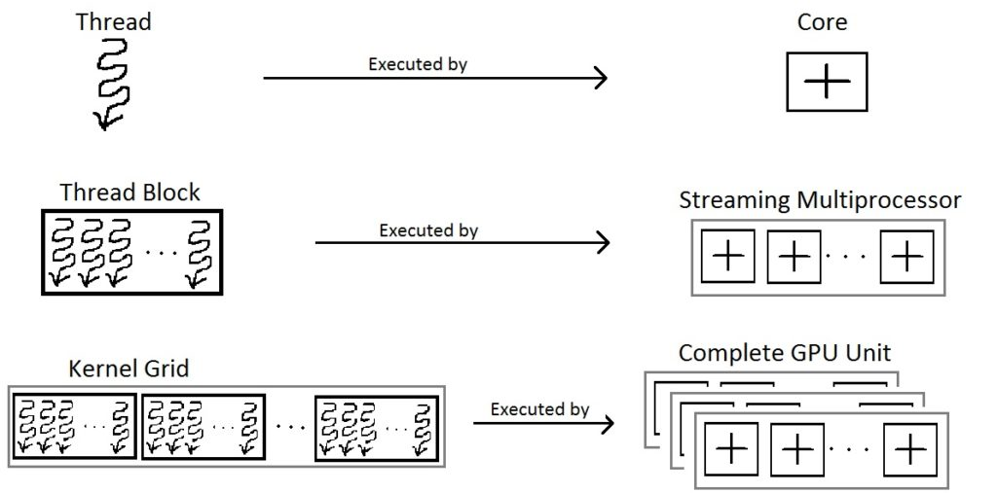
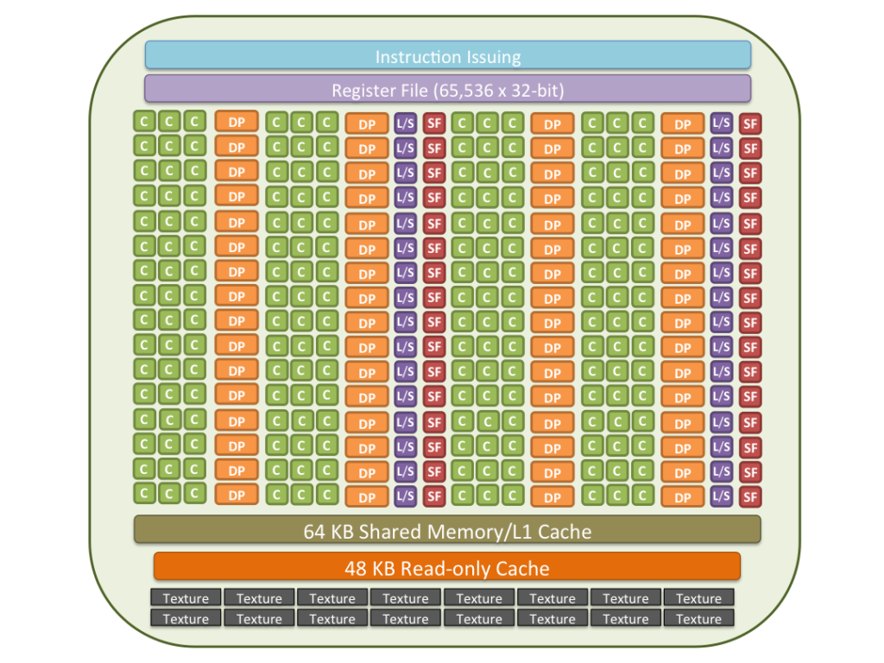
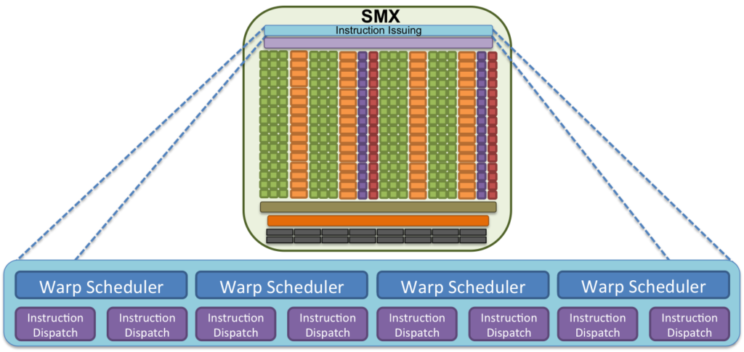

Slide 30
Source files for CUDA applications consist of a mixture of conventional C++ host code, plus GPU device functions. The CUDA compilation trajectory separates the device functions from the host code, compiles the device functions using the proprietary NVIDIA compilers and assembler, compiles the host code using a C++ host compiler that is available, and afterwards embeds the compiled GPU functions as fatbinary images in the host object file. In the linking stage, specific CUDA runtime libraries are added for supporting remote SPMD procedure calling and for providing explicit GPU manipulation such as allocation of GPU memory buffers and host-GPU data transfer.
PTX instructions may or may not be an intermediary between cuda binary and device calls.
Data
Data
Data
Data
Data
Data
Data
Data

Slide 31
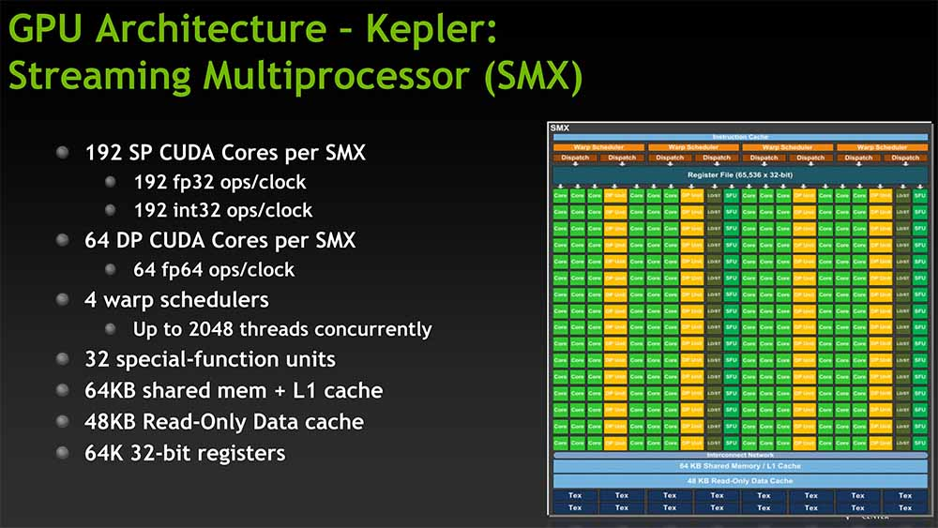
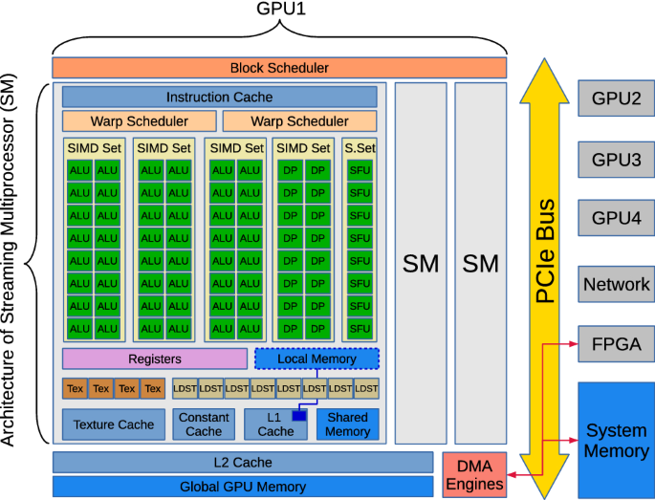
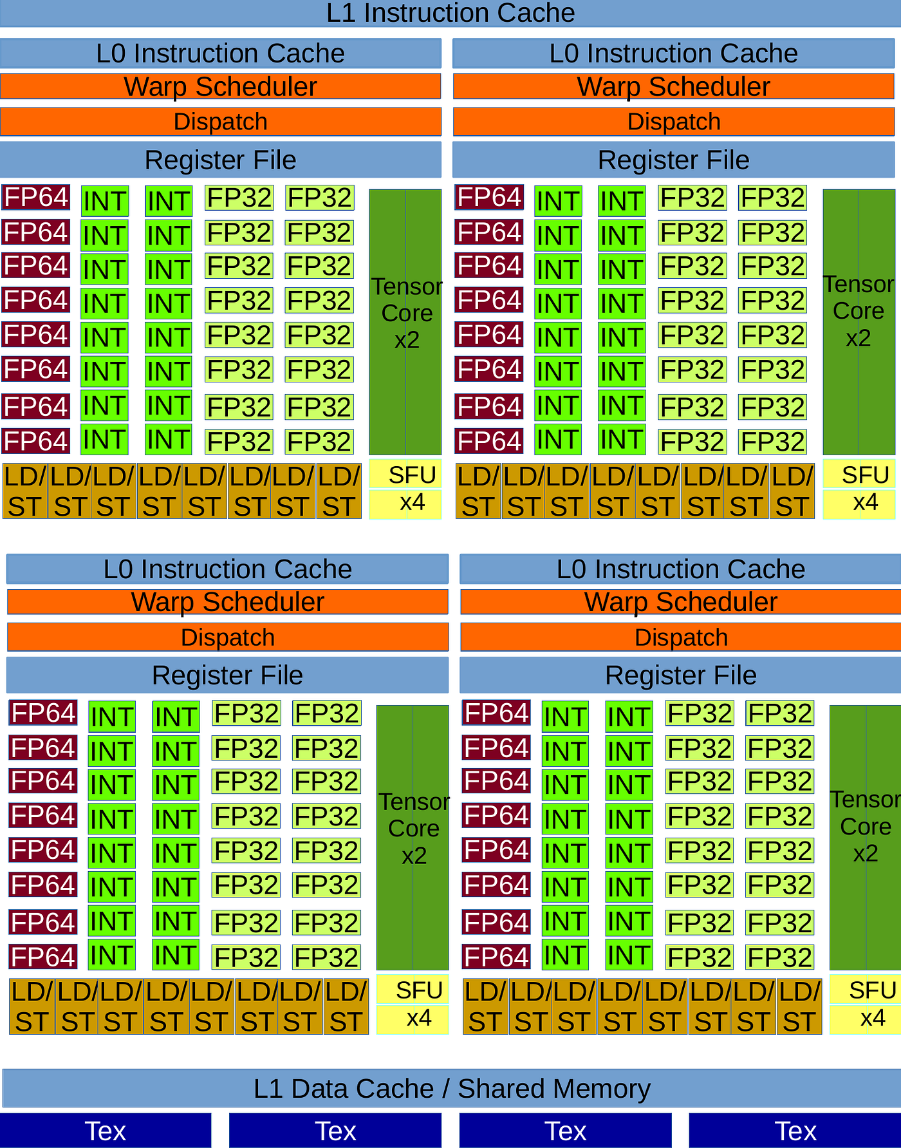
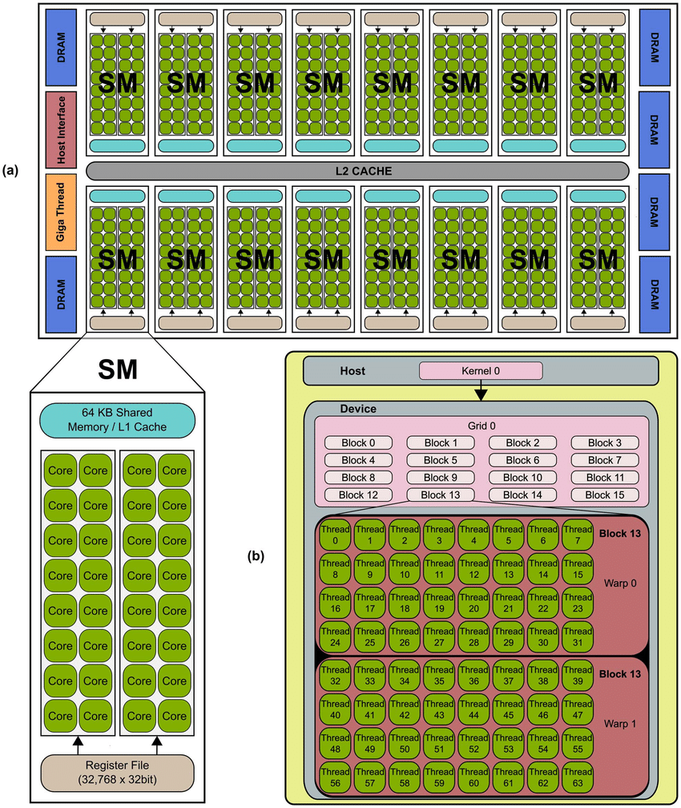
Ok so
I will first define the multitasking problem using diagrams so I can work off that.
Should more or less be focused on cuda multitasking, I’m going to not talk about clusters at all because that’s too much effort at this point.
CUDA Program -> ptx asm/cuda binary -> fatbinary supporting multiple architectures -> cuda runtime libraries linked -> when execute -> kernel grid invocation -> distribute blocks on grid to vacant multiprocessors -> warp scheduling
Partition thread blocks into warps ->
Warp: 32 parallel threads
Scheduler: loose round robin or greediess then oldest
warp optimizes instruction execution by pipelining
Huh. So that’s one reason why models are trained on multiples of 32
I will then cherry pick specific innovations from current parallel processing technology that can be translated into human productivity methods. They will be unique ideas that should follow a "cover all the bases" strategy, each idea addressing typical problems faced by overworked individuals
Sections 7, 12
First gotta establish the CUDA programming model, because that’s our main point of education
Alright so I can look at https://en.wikipedia.org/wiki/Round-robin_scheduling queuing theory for the scheduling section.

Slide 32
Why computers multitask better than you
Hook: write a hook here
Conclusion: write a meaningful conclusion here
Ideas: How do we assign N tasks to M processors? Think in terms of scheduling
Loose Round Robin Scheduling
How can we schedule to take advantage of GPU architecture?
How can we schedule to maximise general efficiency?
How can we schedule to maximize pipelining
Special Function Unit
Greediest-then-oldest Scheduling
Arithmetic Units
Tensor Core
ALU Design and Clock Cycles
Idea that when you have a instruction executing in its 2nd stage, you can call another instruction in its first stage
How scheduling can maximise pipelining
So you want to know how computers multitask?
GPUs use Round Robin Scheduling to delegate tasks, which is to execute the first instruction in all tasks first, then 2nd instruction, 3rd and so forth.
This is useful in that when we execute 1 instruction, we can follow up with another of the same instruction to save time through pipelining.
And since we’re pipelining, we can use specialized cores for optimized calculation of operations to make the pipeline faster overall
So through scheduling, we leverage pipelining which takes advantage of specialization. Thanks for listening.
Notes:
HOW do we make 20 machines do 1 million tasks?
We efficiently allocate the tasks to machines
We allocate tasks such that each stage in the machine is being used
Sometimes tasks needs other tasks to happen first/some tasks needs priority. ->
Factory Analogy probably better here
We schedule tasks to execute the first instruction in all first, then 2nd instruction, 3rd and so forth.
This is useful in that when we execute instruction 1, we can follow up with another instruction 1 to save time through pipelining.
And since we’re pipelining, we can make specific cores for specific work in the gpu, allowing us to specialize among functions
So through scheduling, we leverage pipelining which takes advantage of specialization.

Slide 33
Fatbinary: executable that has code native to multiple instruction sets so it can run on multiple processor types

Slide 34
Slash warp
Round-Robin Scheduling
Greedy-Then-Oldest Scheduling
https://iris.unimore.it/retrieve/ba44950c-891f-4e13-9fa4-e8a83fb3dda0/QoS_Warp_scheduling_designDRAFT.pdf thank you professors for doing my research

Slide 35
cache
Could talk about caching

Slide 36
Cuda cc 9.0
128 FP32 cores for single-precision arithmetic operations,
64 FP64 cores for double-precision arithmetic operations,
64 INT32 cores for integer math,
4 mixed-precision fourth-generation Tensor Cores supporting the new FP8 input type in either E4M3 or E5M2 for exponent (E) and mantissa (M), half-precision (fp16), __nv_bfloat16, tf32, INT8 and double precision (fp64) matrix arithmetic (see Warp Matrix Functions for details) with sparsity support,
16 special function units for single-precision floating-point transcendental functions,
4 warp schedulers.

Slide 37
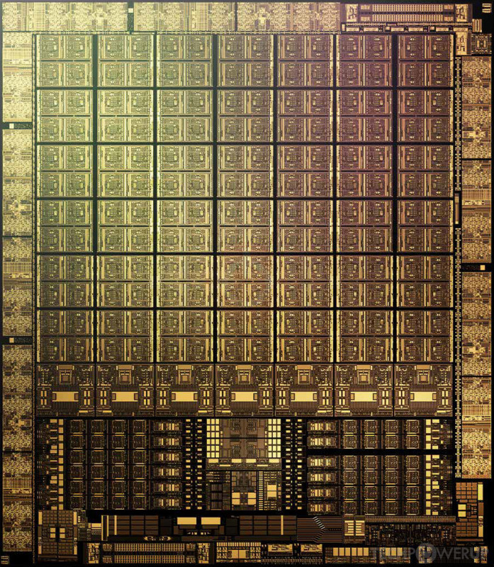
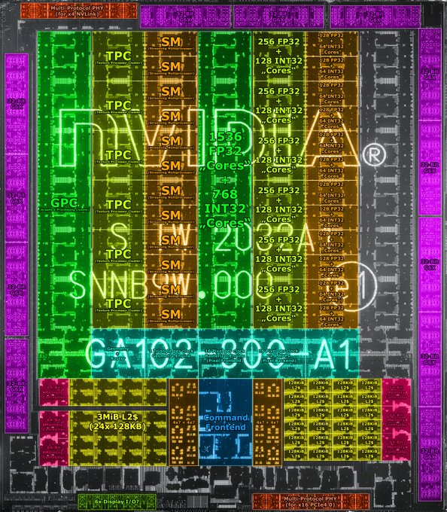
Notes:
Hi there! Our 768 instructions are split into 6 blocks of 4 warps, each warp containing 32 threads. Each warp’s threads are executed for an allocated timeslot, before moving to the next warp. This is known as Round Robin Scheduling.
TO execute a warp, we first pass the

Slide 38
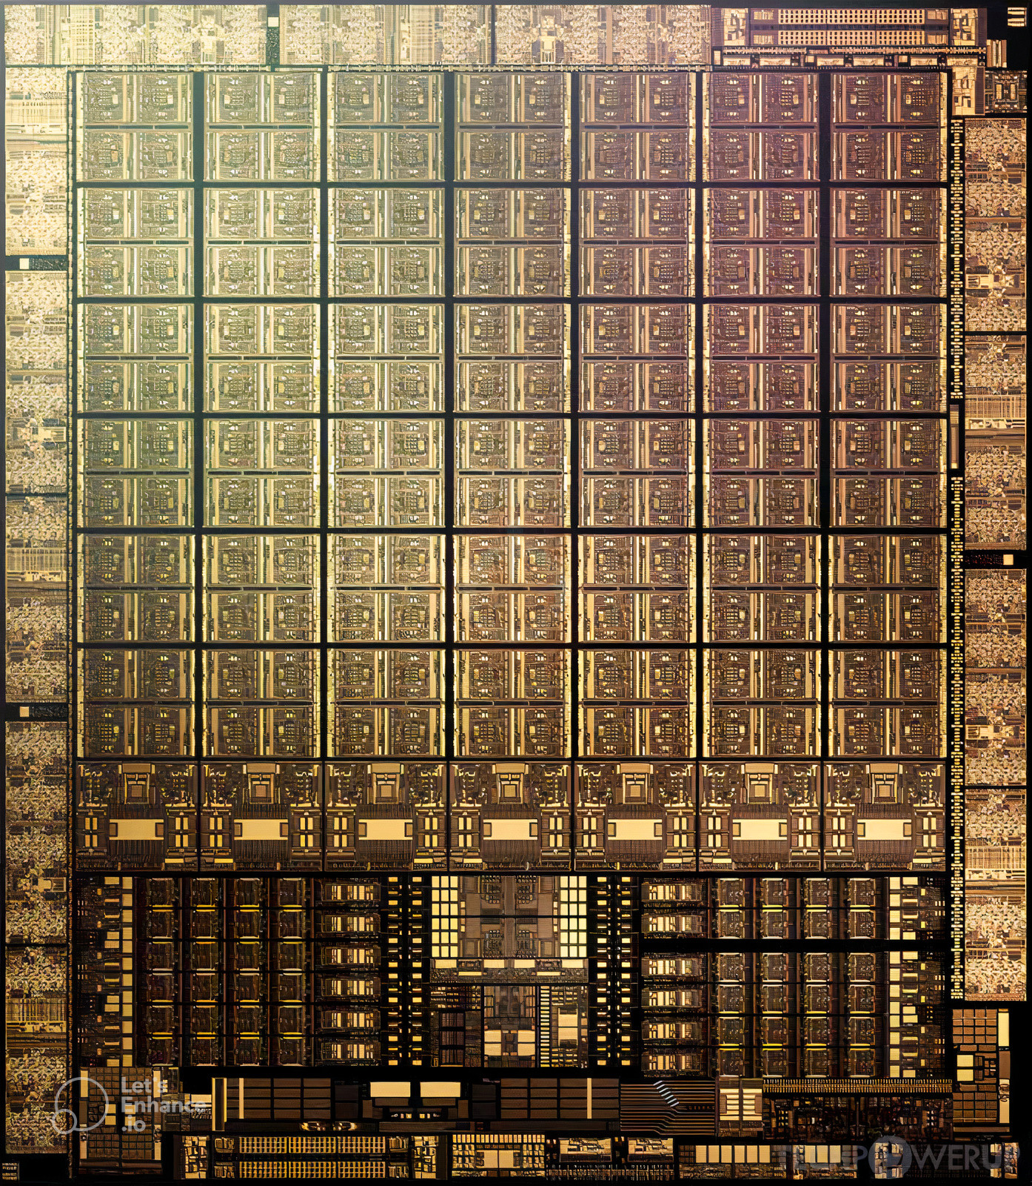
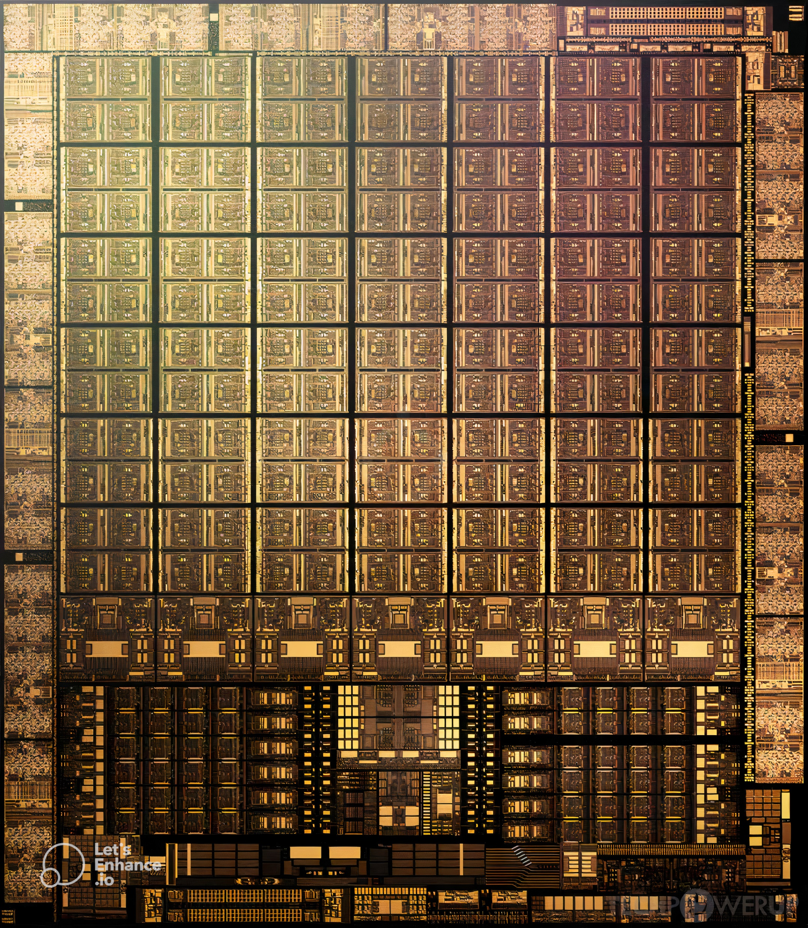
Notes:
Hi there! Our 768 instructions are split into 6 blocks of 4 warps, each warp containing 32 threads. Each warp’s threads are executed for an allocated timeslot, before moving to the next warp. This is known as Round Robin Scheduling.
Per sm
Large block -> 2.
Smaller block near large block: 2
left rectangle array: 4 m 2 small. caches I think. Makes sense to put them near each other.
Right rectangle array: 2 sets of 1 big 1 m
Tiny Block Grid: 2. Cuda cores?
Per smsp
Line: 1
Side blocks: 2
Side side blocks: 4
very mini grid: 2

Slide 39
L1 Instruction Cache
Branch Unit
L0 Instruction Cache
MUFU/XU/SFU Instruction
queue
LSU (FIFO) Instruction Queue
The memory subsystems contains L1, TEX unit, shared memory unit, and other domain specific (e.g. graphics) interfaces to the SM
Warp Scheduler
SFU
SFU
SFU
SFU
LSU
LSU
LSU
LSU
MIO Scheduler
All short scoreboards
All Variable latency
Tensor Core
Math Dispatch Unit
ADU
fp64
What is MIO instruction queue?
Direct dispatch?
CUDA
Core
CUDA
Core
CUDA
Core
CUDA
Core
L1 Dcache/Smem 128kb (LUSIN)
pipelined
fp32
fp32
fp32
fp32
LSUIN
LSU
executes global/local/shared loads/store/atomics and several warp level operations (e.g. VOTE, SHUFFLE).
int32
int32
CUDA
Core
CUDA
Core
CUDA
Core
CUDA
Core
fp32
fp32
fp32
fp32
int32
int32
Tag
Miss
Data
L1 Immediate Constant Cache 2 KB
L1 InDexed Constant Cache 8 KB
CUDA
Core
CUDA
Core
CUDA
Core
CUDA
Core
fp32
fp32
fp32
fp32
int32
int32
CUDA
Core
CUDA
Core
CUDA
Core
CUDA
Core
fp32
fp32
fp32
fp32
L2 Cache
int32
int32
Crossbar
CUDA
Core
CUDA
Core
CUDA
Core
CUDA
Core
fp32
fp32
fp32
fp32
int32
int32
CUDA
Core
CUDA
Core
CUDA
Core
CUDA
Core
fp32
fp32
fp32
fp32
int32
int32
CUDA
Core
CUDA
Core
CUDA
Core
CUDA
Core
fp32
fp32
fp32
fp32
int32
int32
CUDA
Core
CUDA
Core
CUDA
Core
CUDA
Core
Operand buffer
fp32
fp32
fp32
fp32
int32
int32
Register Cache
ALU
64 KB Register File
Notes:
Right so I need to, first figure out how to integrate the indexed constant cache and ADU into the system
What’s difference between indexed constant cache and Immediate Constant Cache
Mio block is guaranteed to request from indexed constant cache, but how.
Lsu unit is located in
mio_throttle (ADU, CBU, LSU, XU)
lg_throttle (LSU)
lg_throttle is used if MIO instruction queue reaches a watermark for local/global instructions. Throttling local/global instructions early allows SM to continue to issue shared memory instructions when L1 backpressure due to local/global L1 misses.
L1Tex partition may refer to more than the texture cache: LSU interface is for shared memory, local/global memory (tagged), and special operations such as shuffle and special purpose registers.
Hi there! Our 768 instructions are split into 6 blocks of 4 warps, each warp containing 32 threads. Each warp’s threads are executed for an allocated timeslot, before moving to the next warp. This is known as Round Robin Scheduling.

Slide 40
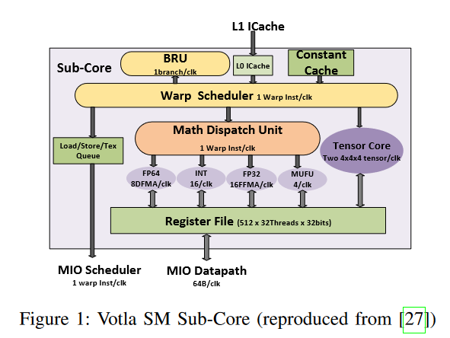
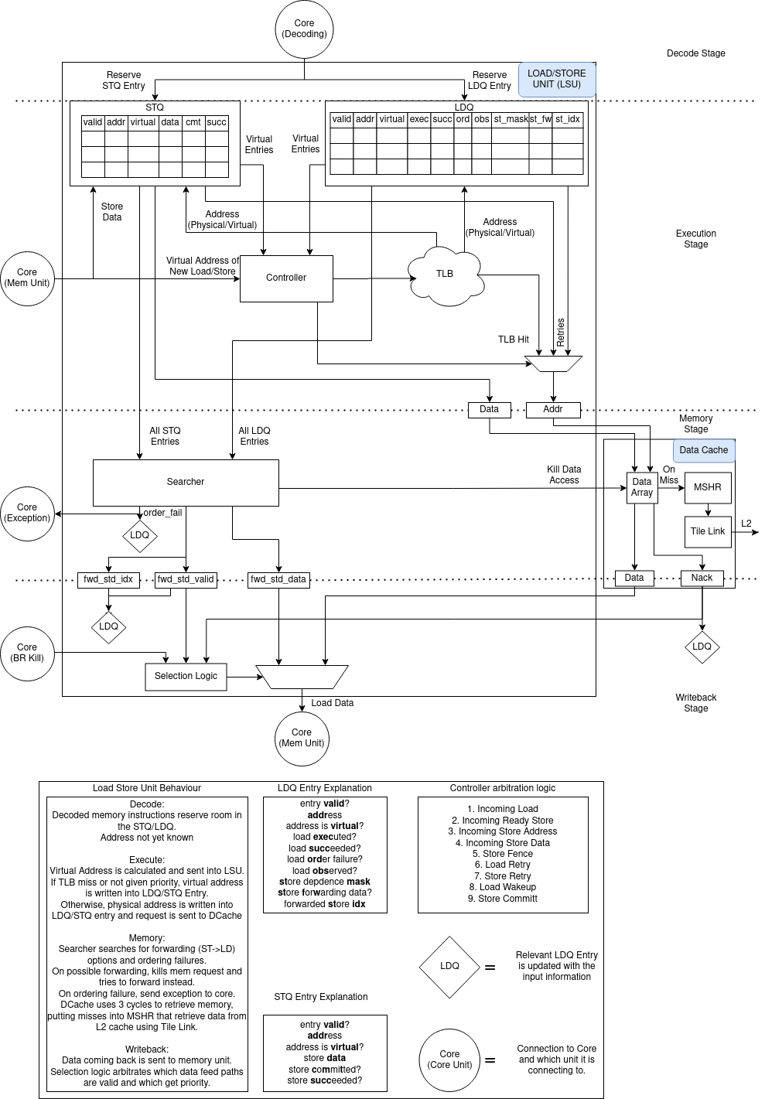
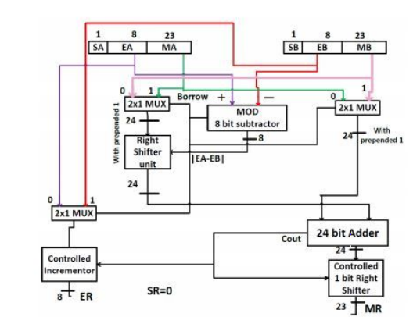

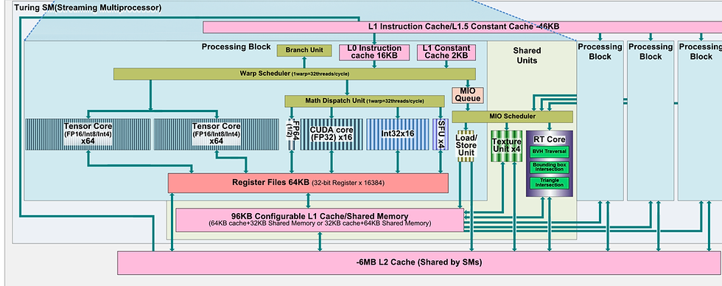
Softmax
Linear
Block Scheduler (find what this does)
Add & Norm
L2 Cache
GDDR6 RAM
Round Robin Scheduler
Feed
Forward
SFU
CUDA
CUDA
Add & Norm
Add & Norm
CUDA
CUDA
SFU
Register file
Multi-Head
Attention
Feed
Forward
CUDA
CUDA
SFU
LDST
LDST
Add & Norm
Tensor
Add & Norm
Tensor
Masked
Multi-Head
Attention
Multi-Head
Attention
L1 Cache
SMEM
Block
Positional
Encoding
Positional
Encoding
Warp 0 | Warp 1 | Warp 2
Thread 0 | Thread 32 | Thread 64
Thread 1 | Thread 33 | Thread 65
… | … | …
Thread 31 | Thread 63 | Thread 95
Input
Embedding
Output
Embedding
Order in which threads are sent to the processor
Inputs
Outputs (shifted right)
Order in which threads are sent to the processor
Notes:
Hi there! Our 768 instructions are split into 6 blocks of 4 warps, each warp containing 32 threads. Each warp’s threads are executed for an allocated timeslot, before moving to the next warp. This is known as Round Robin Scheduling.
TO execute a warp, we first pass the

Slide 41
L1 Instruction Cache
L1.5 InDexed Constant Cache 8 KB
Branch Unit
L0 Instruction Cache
Branch Unit
L0 Instruction Cache
Warp Scheduler
Warp Scheduler
Tensor Core
Math Dispatch Unit
Tensor Core
Math Dispatch Unit
CUDA
Core
CUDA
Core
CUDA
Core
CUDA
Core
CUDA
Core
CUDA
Core
CUDA
Core
CUDA
Core
fp32
fp32
fp32
fp32
fp32
fp32
int32
int32
fp32
fp32
int32
int32
CUDA
Core
CUDA
Core
CUDA
Core
CUDA
Core
CUDA
Core
CUDA
Core
CUDA
Core
CUDA
Core
fp32
fp32
fp32
fp32
fp32
fp32
int32
int32
fp32
fp32
int32
int32
CUDA
Core
CUDA
Core
CUDA
Core
CUDA
Core
CUDA
Core
CUDA
Core
CUDA
Core
CUDA
Core
fp32
fp32
fp32
fp32
fp32
fp32
int32
int32
fp32
fp32
int32
int32
CUDA
Core
CUDA
Core
CUDA
Core
CUDA
Core
CUDA
Core
CUDA
Core
CUDA
Core
CUDA
Core
fp32
fp32
fp32
fp32
fp32
fp32
int32
int32
fp32
fp32
int32
int32
Crossbar
Crossbar
CUDA
Core
CUDA
Core
CUDA
Core
CUDA
Core
CUDA
Core
CUDA
Core
CUDA
Core
CUDA
Core
fp32
fp32
fp32
fp32
fp32
fp32
int32
int32
fp32
fp32
int32
int32
CUDA
Core
CUDA
Core
CUDA
Core
CUDA
Core
CUDA
Core
CUDA
Core
CUDA
Core
CUDA
Core
fp32
fp32
fp32
fp32
fp32
fp32
int32
int32
fp32
fp32
int32
int32
CUDA
Core
CUDA
Core
CUDA
Core
CUDA
Core
CUDA
Core
CUDA
Core
CUDA
Core
CUDA
Core
fp32
fp32
fp32
fp32
fp32
fp32
int32
int32
The memory subsystems contains L1, TEX unit, shared memory unit, and other domain specific (e.g. graphics) interfaces to the SM
fp32
fp32
int32
int32
CUDA
Core
CUDA
Core
CUDA
Core
CUDA
Core
Operand buffer
CUDA
Core
CUDA
Core
CUDA
Core
CUDA
Core
fp32
fp32
fp32
fp32
fp32
fp32
Operand buffer
int32
int32
fp32
fp32
int32
int32
Register Cache
ALU
MUFU/XU/SFU Instruction
queue
LSU (FIFO) Instruction Queue
Register Cache
ALU
64 KB Register File
64 KB Register File
MIO Scheduler
Branch Unit
L0 Instruction Cache
Branch Unit
L0 Instruction Cache
ADU
fp64
pipelined
Warp Scheduler
SFU
SFU
LSU
LSU
Warp Scheduler
SFU
SFU
LSU
LSU
What is MIO instruction queue?
Direct dispatch?
All short scoreboards
All Variable latency
Tensor Core
Math Dispatch Unit
Tensor Core
Math Dispatch Unit
executes global/local/shared loads/store/atomics and several warp level operations (e.g. VOTE, SHUFFLE).
CUDA
Core
CUDA
Core
CUDA
Core
CUDA
Core
CUDA
Core
CUDA
Core
CUDA
Core
CUDA
Core
fp32
fp32
fp32
fp32
fp32
fp32
fp32
fp32
int32
int32
int32
int32
CUDA
Core
CUDA
Core
CUDA
Core
CUDA
Core
L1 Dcache/Smem 128kb (LUSIN)
CUDA
Core
CUDA
Core
CUDA
Core
CUDA
Core
fp32
fp32
fp32
fp32
LSUIN
LSU
fp32
fp32
fp32
fp32
int32
int32
int32
int32
CUDA
Core
CUDA
Core
CUDA
Core
CUDA
Core
CUDA
Core
CUDA
Core
CUDA
Core
CUDA
Core
fp32
fp32
fp32
fp32
fp32
fp32
fp32
fp32
int32
int32
Tag
Miss
Data
int32
int32
CUDA
Core
CUDA
Core
CUDA
Core
CUDA
Core
CUDA
Core
CUDA
Core
CUDA
Core
CUDA
Core
fp32
fp32
fp32
fp32
fp32
fp32
fp32
fp32
int32
int32
int32
int32
Crossbar
Crossbar
CUDA
Core
CUDA
Core
CUDA
Core
CUDA
Core
CUDA
Core
CUDA
Core
CUDA
Core
CUDA
Core
fp32
fp32
fp32
fp32
fp32
fp32
fp32
fp32
int32
int32
int32
int32
CUDA
Core
CUDA
Core
CUDA
Core
CUDA
Core
CUDA
Core
CUDA
Core
CUDA
Core
CUDA
Core
fp32
fp32
fp32
fp32
fp32
fp32
fp32
fp32
int32
int32
int32
int32
CUDA
Core
CUDA
Core
CUDA
Core
CUDA
Core
CUDA
Core
CUDA
Core
CUDA
Core
CUDA
Core
fp32
fp32
fp32
fp32
fp32
fp32
fp32
fp32
int32
int32
int32
int32
CUDA
Core
CUDA
Core
CUDA
Core
CUDA
Core
Operand buffer
CUDA
Core
CUDA
Core
CUDA
Core
CUDA
Core
Operand buffer
fp32
fp32
fp32
fp32
fp32
fp32
fp32
fp32
int32
int32
int32
int32
Register Cache
ALU
Register Cache
ALU
64 KB Register File
64 KB Register File
Notes:
Right so I need to, first figure out how to integrate the indexed constant cache and ADU into the system
What’s difference between indexed constant cache and Immediate Constant Cache
Mio block is guaranteed to request from indexed constant cache, but how.
Lsu unit is located in
mio_throttle (ADU, CBU, LSU, XU)
lg_throttle (LSU)
lg_throttle is used if MIO instruction queue reaches a watermark for local/global instructions. Throttling local/global instructions early allows SM to continue to issue shared memory instructions when L1 backpressure due to local/global L1 misses.
L1Tex partition may refer to more than the texture cache: LSU interface is for shared memory, local/global memory (tagged), and special operations such as shuffle and special purpose registers.
Hi there! Our 768 instructions are split into 6 blocks of 4 warps, each warp containing 32 threads. Each warp’s threads are executed for an allocated timeslot, before moving to the next warp. This is known as Round Robin Scheduling.

Slide 42
L1 Instruction Cache
Branch Unit
L0 Instruction Cache
Warp Scheduler
Instruction Counter
Tensovr Core
Math Dispatch Unit
MUFU/XU/SFU Instruction
queue
LSU (FIFO) Instruction Queue
The memory subsystems contains L1, TEX unit, shared memory unit, and other domain specific (e.g. graphics) interfaces to the SM
CUDA
Core
CUDA
Core
CUDA
Core
CUDA
Core
fp32
fp32
fp32
fp32
int32
int32
CUDA
Core
CUDA
Core
CUDA
Core
CUDA
Core
MIO Scheduler
fp32
fp32
fp32
fp32
All short scoreboards
All Variable latency
int32
int32
CUDA
Core
CUDA
Core
CUDA
Core
CUDA
Core
What is MIO instruction queue?
Direct dispatch?
fp32
fp32
fp32
fp32
ADU
fp64
int32
int32
pipelined
SFU
SFU
LSU
LSU
executes global/local/shared loads/store/atomics and several warp level operations (e.g. VOTE, SHUFFLE).
Crossbar
CUDA
Core
CUDA
Core
CUDA
Core
CUDA
Core
fp32
fp32
fp32
fp32
SFU
SFU
LSU
LSU
int32
int32
Crossbar
CUDA
Core
CUDA
Core
CUDA
Core
CUDA
Core
fp32
fp32
fp32
fp32
int32
int32
Math Dispatch Unit
CUDA
Core
CUDA
Core
CUDA
Core
L1 Immediate Constant Cache 2 KB
64 KB Register File
fp32
CUDA
Core
fp32
fp32
fp32
int32
int32
CUDA
Core
CUDA
Core
CUDA
Core
CUDA
Core
L1 InDexed Constant Cache 8 KB
L2 Cache
fp32
fp32
fp32
fp32
int32
int32
CUDA
Core
CUDA
Core
CUDA
Core
CUDA
Core
L1 Dcache/Smem 128kb (LUSIN)
fp32
fp32
Operand buffer
LSUIN
LSU
fp32
fp32
int32
int32
Operand buffer
Register Cache
ALU
Register Cache
Tag
Miss
Data
CUDA
Core
Tensovr Core
SFU
CUDA
Core
64 KB Register File
SFU
SFU
Operand Buffer
Math Dispatch Unitv
Warp Scheduler
Branch Unit
SFU
ALU
Branch Unit
LSU
L1 idxCache
L1 immCache
L0 ICache
Tensor Core
L1 ICache
Crossbar
L1 DCache
Register File
Int/fp16 cores
Register Cache
Fp16 cores
Warp Schduler
SFU
ALU
SFU
Notes:
Right so I need to, first figure out how to integrate the indexed constant cache and ADU into the system
What’s difference between indexed constant cache and Immediate Constant Cache
Mio block is guaranteed to request from indexed constant cache, but how.
Lsu unit is located in
mio_throttle (ADU, CBU, LSU, XU)
lg_throttle (LSU)
lg_throttle is used if MIO instruction queue reaches a watermark for local/global instructions. Throttling local/global instructions early allows SM to continue to issue shared memory instructions when L1 backpressure due to local/global L1 misses.
L1Tex partition may refer to more than the texture cache: LSU interface is for shared memory, local/global memory (tagged), and special operations such as shuffle and special purpose registers.
Hi there! Our 768 instructions are split into 6 blocks of 4 warps, each warp containing 32 threads. Each warp’s threads are executed for an allocated timeslot, before moving to the next warp. This is known as Round Robin Scheduling.

Slide 43
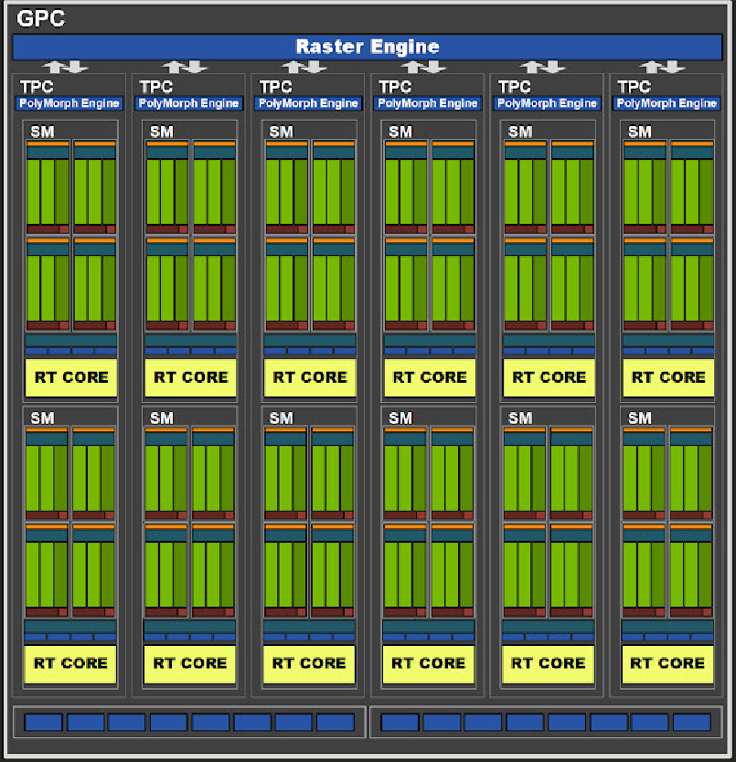
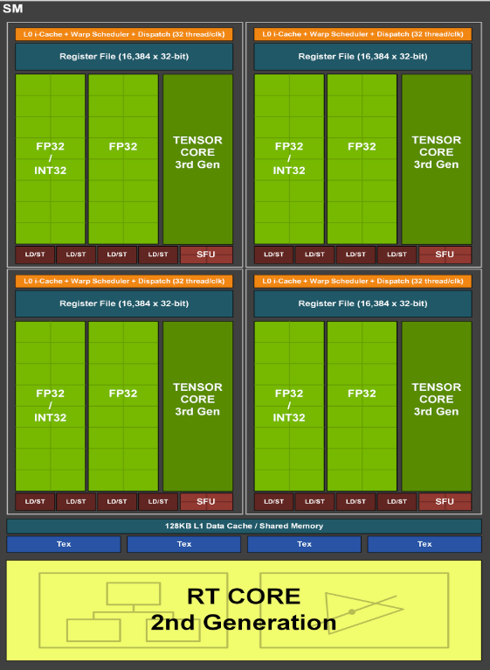

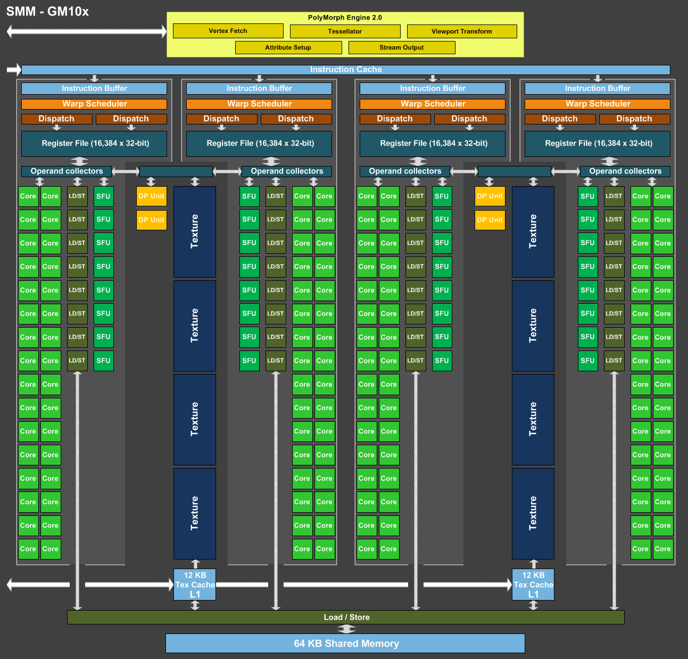
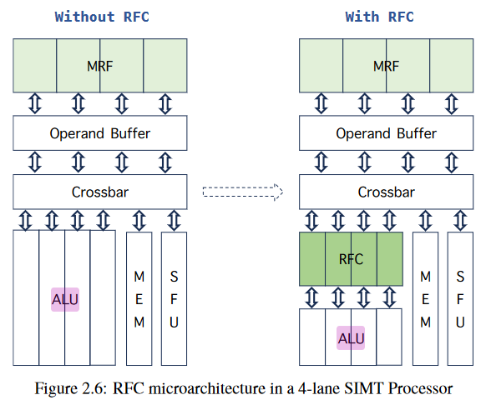
adu | Address Divergence Unit. The ADU is responsible for address divergence handling for branches/jumps. It also provides support for constant loads and block-level barrier instructions.
alu | Arithmetic Logic Unit. The ALU is responsible for execution of most bit manipulation and logic instructions. It also executes integer instructions, excluding IMAD and IMUL. On NVIDIA Ampere architecture chips, the ALU pipeline performs fast FP32-to-FP16 conversion.
cbu | Convergence Barrier Unit. The CBU is responsible for warp-level convergence, barrier, and branch instructions.
fma | Fused Multiply Add/Accumulate. The FMA pipeline processes most FP32 arithmetic (FADD, FMUL, FMAD). It also performs integer multiplication operations (IMUL, IMAD), as well as integer dot products. On GA10x, FMA is a logical pipeline that indicates peak FP32 and FP16x2 performance. It is composed of the FMAHeavy and FMALite physical pipelines.
fmaheavy | Fused Multiply Add/Accumulate Heavy. FMAHeavy performs FP32 arithmetic (FADD, FMUL, FMAD), FP16 arithmetic (HADD2, HMUL2, HFMA2), integer multiplication operations (IMUL, IMAD), and integer dot products.
fmalite | Fused Multiply Add/Accumulate Lite. FMALite performs FP32 arithmetic (FADD, FMUL, FMA) and FP16 arithmetic (HADD2, HMUL2, HFMA2).
fp16 | Half-precision floating-point. On Volta, Turing and NVIDIA GA100, the FP16 pipeline performs paired FP16 instructions (FP16x2). It also contains a fast FP32-to-FP16 and FP16-to-FP32 converter. Starting with GA10x chips, this functionality is part of the FMA pipeline.
fp64 | Double-precision floating-point. The implementation of FP64 varies greatly per chip.
lsu | Load Store Unit. The LSU pipeline issues load, store, atomic, and reduction instructions to the L1TEX unit for global, local, and shared memory. It also issues special register reads (S2R), shuffles, and CTA-level arrive/wait barrier instructions to the L1TEX unit.
tex | Texture Unit. The SM texture pipeline forwards texture and surface instructions to the L1TEX unit’s TEXIN stage. On GPUs where FP64 or Tensor pipelines are decoupled, the texture pipeline forwards those types of instructions, too.
tma | Tensor Memory Access Unit. Provides efficient data transfer mechanisms between global and shared memories with the ability to understand and traverse multidimensional data layouts.
uniform | Uniform Data Path. This scalar unit executes instructions where all threads use the same input and generate the same output.
xu | Transcendental and Data Type Conversion Unit. The XU pipeline is responsible for special functions such as sin, cos, and reciprocal square root. It is also responsible for int-to-float, and float-to-int type conversions.
2048 cuda cores
16 SMs
L2 Cache: 2048kb
64 tensor cores
2 fp64s per subSM
4 SFU per subSM
(supposed to have 32 fp64)
Mio unit
I can skim over all caching
128 KB
Judging by greg this is probably correct
L1 Instruction Cache
L1.5 InDexed Constant Cache 8 KB
8.4.1. mmio Operation
An mmio operation is a memory operation with .mmio qualifier specified. It is usually performed on a memory location which is mapped to the control registers of peer I/O devices. It can also be used for communication between threads but has poor performance relative to non-mmio operations.
The semantic meaning of mmio operations cannot be defined precisely as it is defined by the underlying I/O device. For formal specification of semantics of mmio operation from Memory Consistency Model perspective, it is equivalent to the semantics of a strong operation. But it follows a few implementation-specific properties, if it meets the CUDA atomicity requirements at the specified scope:
Writes are always performed and are never combined within the scope specified.
Reads are always performed, and are not forwarded, prefetched, combined, or allowed to hit any cache within the scope specified.
As an exception, in some implementations, the surrounding locations may also be loaded. In such cases the amount of data loaded is implementation specific and varies between 32 and 128 bytes in size.
Branch Unit
L0 Instruction Cache
Warp Scheduler
Tensor Core
Math Dispatch Unit
MIO
Block
CUDA
Core
CUDA
Core
CUDA
Core
CUDA
Core
MUFU Instruction
queue
LSU Queue
fp32
fp32
fp32
fp32
int32
int32
MIO Scheduler
CUDA
Core
CUDA
Core
CUDA
Core
CUDA
Core
fp64
Mio block shared between all subprocessors
fp32
fp32
fp32
fp32
Emulated
Does not
exist
int32
int32
SFU
SFU
LSU
LSU
SFU
SFU
LSU
LSU
CUDA
Core
CUDA
Core
CUDA
Core
CUDA
Core
fp32
fp32
fp32
fp32
Lsu pipeline
int32
int32
When a load request is issued to L1 the LSU needs to perform an address divergence calculation to determine which threads are accessing the same cache line. The LSU unit then has to perform a L1 cache tag look up. If the line is cached then it is written back to the register file; otherwise, the request is sent to L2. If the warp has threads not serviced by the request then a replay is requested and the operation is reissued with the remaining threads.
CUDA
Core
CUDA
Core
CUDA
Core
CUDA
Core
fp32
fp32
fp32
fp32
int32
int32
Crossbar
CUDA
Core
CUDA
Core
CUDA
Core
CUDA
Core
Mio datapath
fp32
fp32
fp32
fp32
int32
int32
CUDA
Core
CUDA
Core
CUDA
Core
CUDA
Core
fp32
fp32
fp32
fp32
int32
int32
CUDA
Core
CUDA
Core
CUDA
Core
CUDA
Core
fp32
fp32
fp32
fp32
int32
int32
ADU
CUDA
Core
CUDA
Core
CUDA
Core
CUDA
Core
Operand buffer
fp32
fp32
fp32
fp32
int32
int32
Register Cache
ALU
64 KB Register File
L1 Dcache/Smem 128kb (MIO)
On Volta - Ampere the MIO (Memory Input Output) block consists of the LSU (Load Store Unit), Address Divergent Unit, Texture Unit, and slow math units (FP64 on non-compute parts, and Tensor on TU116/7). Instructions to these units are issued to instruction queues between the Sub-Core (profiler’s use the term sub-partition) and the MIO scheduler. The MIO scheduler dispatches instructions to these shared execution units.
The LSU executes global/local/LSU instruction queue is a FIFO of instructions sent to the Load Store Unit.
shared loads/store/atomics and several warp level operations (e.g. VOTE, SHUFFLE).
The MIO has separate instruction queues for other execution units including TEX and MUFU (XU in most tools).
The instruction queue for global/local and shared has a set watermark for global/local operations. If the watermark is reached any warp with the next instruction of type global/local LSU is stalled on LG throttle. The watermark is set to ensure that shared memory operations can still issue when L1 global/local (tagged accesses) pipeline is backed up. This can happen if the SM issues a lot of memory loads that miss in L2. If the next instruction of a warp is to any MIO instruction queue other than TEX and the queue is full (e.g. XU/MUFU, ADU) then the warp will report stalled on MIO throttle. TEX instruction queue has a separate stall reason called TEX throttle. The other queues do not have separate reasons as the queues vary between chips.
Address Divergence Unit. The ADU is responsible for address divergence handling for branches/jumps. It also provides support for constant loads and block-level barrier instructions.
Defining array as constant and accessing via an index will result in use of indexed constant cache. Depending on the GPU there is one indexed constant cache per SM or TPC resulting in a maximum access rate of 0.5 or 1 instruction per cycle per SM. The indexed constant cache is accessed via the MIO unit. The low instruction throughput will result in warps stalling to issued the LDC (load constant instruction). If threads have different indexes then the instruction is replayed in the MIO ADU (address divergence unit) for each divergence increasing the number of warps that are stalling on MIO throttle.
If you would like more information on possible solutions it would be helpful if you would provide the following information:
GPU
Calculation of i
Number of times each warp will perform the above code
If all threads have the same value i you are accessing this at maximum performance. L1 and shared memory would give the same performance. If all threads in the warp have different value of i then shared memory and/or cached L1 would be up to 31x more performant. If each warp only reads once then I would recommend trying cached L1 first. If warps are reading the data more than once then you may want to use shared memory.
Instruction level parallelism can also be accomplished if a sequence of instructions have no dependencies between each other. An execution dependency would require a stall until the dependency is resolved. This can be done even to the same pipeline.
- A warp contains 32 threads. Does this means that it requires 32 / 8 = 4 cycles to dispatch all 32 double precision instructions in a warp, and 32 / 16 = 2 cycles for int / single precision instructions, 32 / 8 = 4 cycles for load / store instructions, 32 / 1 = 32 cycles for special function instructions?
Math Dispatch Unit: Your statement is correct for most double precision, fp32, integer, and special function instructions that are dispatched to execution units in the SM sub-partitions.
Load/store instructions are issued to a unit that is shared by 4 SM sub-partitions (Kepler - Volta, excluding GP100). Load/store instructions are dispatch to a FIFO for the shared unit.
L1 idxCache
L1 immCache
L0 ICache
Tensor Core
L1 ICache
Crossbar
L1 DCache
Register File
Int/fp16 cores
Register Cache
Fp16 cores
Warp Schduler
SFU
ALU
SFU
An illustration of RFC microarchitecture in a 4-lane SIMT processor is shown
in Figure 2.6. In the computing pipeline, the operands are fetched from MRF
and pushed into the operand buffer. The operands then go through a crossbar
which acts as a router to deliver the register data to the corresponding execution
units like the) normal Arithmetic Logic Unit (ALU), the Special Function Unit
(SFU), and the memory load/store unit (MEM. RFC is placed in between the
operands buffer and the ALUs. As RFC resides the closest to the ALUs and
the data comes from RFC skips the operand buffer and the interconnect, it
provides the lowest register access latency and largely mitigates the traffic
to MRF.
Notes:
Right so I need to, first figure out how to integrate the indexed constant cache and ADU into the system
What’s difference between indexed constant cache and Immediate Constant Cache
Mio block is guaranteed to request from indexed constant cache, but how.
Lsu unit is located in
mio_throttle (ADU, CBU, LSU, XU)
lg_throttle (LSU)
lg_throttle is used if MIO instruction queue reaches a watermark for local/global instructions. Throttling local/global instructions early allows SM to continue to issue shared memory instructions when L1 backpressure due to local/global L1 misses.
L1Tex partition may refer to more than the texture cache: LSU interface is for shared memory, local/global memory (tagged), and special operations such as shuffle and special purpose registers.
Hi there! Our 768 instructions are split into 6 blocks of 4 warps, each warp containing 32 threads. Each warp’s threads are executed for an allocated timeslot, before moving to the next warp. This is known as Round Robin Scheduling.

Slide 44
Short Scoreboard : Waiting for short latency MIO or RTCORE data dependency.
Includes 3D attribute load/store, pixel attribute interpolation, compute shared memory load/store, indexed constant loads, transcendentals (rcp, rsqrt, …) through the SFU pipe (aka XU pipe), VOTE, and a few other infrequent instructions. partition in the NVIDIA SM
contains shared execution units or slower math execution units (e.g. XU pipe).
instruction queues allowing warp schedulers issue independent instructions from warp. Queue full->stall->throttle
The mapping of instruction queues to pipes differs between chips. This is the general mapping.
mio_throttle (ADU, CBU, LSU, XU): local, global, shared, attribute, IPA, indexed constant loads (LDC), and decoupled math
lg_throttle (LSU): lg_throttle is used if MIO fifo instruction queue reaches a watermark for local/global instructions. Throttling local/global instructions early allows SM to continue to issue shared memory instructions when L1 backpressure due to local/global L1 misses.
tex_throttle (TEX, FP64 on non-*100 chips, Tensor on TU11x)
If the warp's next instruction to issue is to a sub-partition specific execution unit (FMA, ALU, Tensor, FP64 (*100 GPUs) then the stall reason is math_throttle.
MIO can issue 1 instruction to LSUIN per cycle and 1 instruction to TEXIN per cycle
Defining array as constant+ accessing via index ->ICC.
Depending on the GPU there is one indexed constant cache per SM or TPC resulting in a maximum access rate of 0.5 or 1 instruction per cycle per SM.
The indexed constant cache is accessed via the MIO unit.
The low instruction throughput -> warps issue load constant instruction. If threads have different indexes then the instruction is replayed in the MIO ADU (address divergence unit) for each divergence increasing the number of warps that are stalling on MIO throttle. If all threads have the same value i you are accessing this at maximum performance. L1 and shared memory would give the same performance. If all threads in the warp have different value of i then shared memory and/or cached L1 would be up to 31x more performant. If each warp only reads once then I would recommend trying cached L1 first. If warps are reading the data more than once then you may want to use shared memory.
8.4.1. mmio Operation
An mmio operation is a memory operation with .mmio qualifier specified. It is usually performed on a memory location which is mapped to the control registers of peer I/O devices. It can also be used for communication between threads but has poor performance relative to non-mmio operations.
The semantic meaning of mmio operations cannot be defined precisely as it is defined by the underlying I/O device. For formal specification of semantics of mmio operation from Memory Consistency Model perspective, it is equivalent to the semantics of a strong operation. But it follows a few implementation-specific properties, if it meets the CUDA atomicity requirements at the specified scope:
Writes are always performed and are never combined within the scope specified.
Reads are always performed, and are not forwarded, prefetched, combined, or allowed to hit any cache within the scope specified.
As an exception, in some implementations, the surrounding locations may also be loaded. In such cases the amount of data loaded is implementation specific and varies between 32 and 128 bytes in size.
4x Subcore
L1TEX partition/block
MIO partition/block
On Volta - Ampere the MIO (Memory Input Output) block consists of the LSU (Load Store Unit), Address Divergent Unit, Texture Unit, and slow math units (FP64 on non-compute parts, and Tensor on TU116/7). Instructions to these units are issued to instruction queues between the Sub-Core (profiler’s use the term sub-partition) and the MIO scheduler. The MIO scheduler dispatches instructions to these shared execution units.
LSU instruction queue is a FIFO of instructions sent to the Load Store Unit.
The LSU executes global/local/shared loads/store/atomics and several warp level operations (e.g. VOTE, SHUFFLE).
The MIO has separate instruction queues for other execution units including TEX and MUFU (XU in most tools).
The instruction queue for global/local and shared has a set threshold for global/local operations. If the threshold is reached any warp with the next instruction of type global/local LSU is stalled on LG throttle. The watermark is set to ensure that shared memory operations can still issue when L1 global/local (tagged accesses) pipeline is backed up. This can happen if the SM issues a lot of memory loads that miss in L2. If the next instruction of a warp is to full queue then MIO throttle.
Async instruction issue. Queue full->stall->throttle
MUFU/XU/SFU Instruction
queue
LSU (FIFO) Instruction Queue
What is MIO instruction queue?
Direct dispatch?
MIO Scheduler
Each cycle the warp scheduler issue instruction-> LSU/MIO iqueue. Each cycle the MIO unit issue instruction -> LSU pipe. This limits the issue rate from 4 IPC per SM to 1 IPC per SM. An instruction cannot be dispatched from MIOC until all registers have been read from the register file. The compiler may update a scoreboard to enable the registers to be re-used. If the warp will report long score board until the registers are available. The compiler may also choose to wait until the instruction has returned (e.g. load). If a warp hits an instruction waiting on the register the warp will be stalled on long scoreboard. Load store instructions are dispatched to the shared memory pipe or the tagged pipe. The load store pipeline calculates the tag for each thread. Threads are grouped together. On GV100+ the L1TEX tag stage can resolve 4 sets x 4 sectors per cycle. If not all threads can be resolved in one wavefront then the instruction will continue to generate new wavefronts in the tag stage until all threads are handled.
When a warp needs to execute a load/store instruction, it’s asynchronously handed over to an LSU unit, allowing the warp to proceed with the next instruction that doesn’t depend on the current load/store instruction.
The LSU pipeline accepts 1 instruction per cycle. The LSU pipeline can contain 100s of inflight instructions.
The compiler can choose to release a scoreboard after the MIO has dispatched the instruction to LSU and/or after the instruction has retired.
Based on your description, my understanding is: each LSU has its own request queue, and when a warp executes load/store instructions, it generates up to 32 requests, which are then added to a specific LSU’s request queue. The LSU then executes one of these requests per cycle (if downstream hardware is sufficiently idle to not hinder the LSU from executing a particular request).
The MIO instruction queue (shallow) is before the LSU unit. The LSU pipe will continue to generate new wavefronts in the t-stage for set conflicts. Wavefronts are generated every cycle. A warp that does a store to 32 different sectors will generate 32 wavefronts. The shared memory and tag pipeline operate simultaneously. A 32-bit load of consecutive 4-byte addresses can complete in 1 t-stage wavefront and 4 miss stage wavefronts.
LSU
The memory subsystems contains L1, TEX unit, shared memory unit, and other domain specific (e.g. graphics) interfaces to the SM
fp64
SFU
SFU
LSU
LSU
All short scoreboards
All Variable latency
pipelined
SFU
SFU
LSU
LSU
ADU
executes global/local/shared loads/store/atomics and several warp level operations (e.g. VOTE, SHUFFLE).
Long Scoreboard: Warp was stalled waiting for a scoreboard dependency on a L1TEX (local, global, surface, tex) operation. To reduce the number of cycles waiting on L1TEX data accesses verify the memory access patterns are optimal for the target architecture, attempt to increase cache hit rates by increasing data locality, or by changing the cache configuration, and consider moving frequently used data to shared memory.`
Short Scoreboard: Warp was stalled waiting for a scoreboard dependency (wait for data) on a MIO (memory input/output) operation (not to L1TEX). The primary reason for a high number of stalls due to short scoreboards is typically memory operations to shared memory. Other reasons include frequent execution of special math instructions (e.g. MUFU) or dynamic branching (e.g. BRX, JMX). Verify if there are shared memory operations and reduce bank conflicts, if applicable.
The LSU executes global/local/shared loads/store/atomics and several warp level operations (e.g. VOTE, SHUFFLE)+special purpose registers
Fixed latency: math, bitwise, register movement
Variable latency: ld/st to shared, local, global, and texture as well as slow math operations
Short scoreboards are reported for dependencies coming for variable latency instructions that will not leave the SM such as slow math such as reciprocal sqrt or shared memory). Long scoreboards are reported for dependencies that may leave the SM such as global/local memory accesses and texture fetches.
Long Scoreboard
Warp was stalled waiting for a scoreboard dependency on a L1TEX (local, global, surface, tex) operation. To reduce the number of cycles waiting on L1TEX data accesses verify the memory access patterns are optimal for the target architecture, attempt to increase cache hit rates by increasing data locality, or by changing the cache configuration, and consider moving frequently used data to shared memory.`
Short Scoreboard
Warp was stalled waiting for a scoreboard dependency on a MIO (memory input/output) operation (not to L1TEX). The primary reason for a high number of stalls due to short scoreboards is typically memory operations to shared memory. Other reasons include frequent execution of special math instructions (e.g. MUFU) or dynamic branching (e.g. BRX, JMX). Verify if there are shared memory operations and reduce bank conflicts, if applicable.
MIO vs. L1TEX
MIO and L1TEX are partitions in the NVIDIA SM. The MIO units is responsible for shared execution units (shared by 1 or more SM sub-partitions) including lower rate math units (e.g. double precision on a GeForce chip) and memory input/output. The memory subsystems contains L1, TEX unit, shared memory unit, and other domain specific (e.g. graphics) interfaces to the SM. The implementation of the MIO subsystem including L1, TEX, and shared memory varies greatly between Kepler, Maxwell-Pascal, and Volta-Ampere. SM sub-partitions (warp schedulers) issues instructions to shared execution units through instruction queues vs. direct dispatch. For SM 7.0+ there are stall reasons (mio_throttle, lg_throttle, and tex_throttle) that occur if the instruction queues for those units are full.
What is included in the definition of MIO varies by architecture.
L1TEX is technically in the MIO partition. The L1TEX has is complicated as it has two input interfaces:
LSU interface is for shared memory, local/global memory (tagged), and special operations such as shuffle and special purpose registers.
TEX interface is for texture fetches and on 7.0-8.x a subset of the slow math operations (e.g. FP64 on a GeForce card). The latter is a little confusing. The slow math units exist for binary compatibility and not expected to be used at the same time as texture fetches.
The term MIO can be confusing. The term L1TEX can also be confusing given two different interfaces. While there are two interfaces local/global and texture/surface share the same cache lookup stages, same cache RAM, and same SM to L2 interface so for many metrics the term L1TEX is used to refer to the unit.

Slide 45
8.4.1. mmio Operation
An mmio operation is a memory operation with .mmio qualifier specified. It is usually performed on a memory location which is mapped to the control registers of peer I/O devices. It can also be used for communication between threads but has poor performance relative to non-mmio operations.
The semantic meaning of mmio operations cannot be defined precisely as it is defined by the underlying I/O device. For formal specification of semantics of mmio operation from Memory Consistency Model perspective, it is equivalent to the semantics of a strong operation. But it follows a few implementation-specific properties, if it meets the CUDA atomicity requirements at the specified scope:
Writes are always performed and are never combined within the scope specified.
Reads are always performed, and are not forwarded, prefetched, combined, or allowed to hit any cache within the scope specified.
As an exception, in some implementations, the surrounding locations may also be loaded. In such cases the amount of data loaded is implementation specific and varies between 32 and 128 bytes in size.
MUFU Instruction
queue
LSU Queue
MIO Scheduler
fp64
SFU
SFU
LSU
LSU
When a load request is issued to L1 the LSU needs to perform an address divergence calculation to determine which threads are accessing the same cache line. The LSU unit then has to perform a L1 cache tag look up. If the line is cached then it is written back to the register file; otherwise, the request is sent to L2. If the warp has threads not serviced by the request then a replay is requested and the operation is reissued with the remaining threads.
SFU
SFU
LSU
LSU
The NVIDIA GPU has two classification of instructions:
Fixed latency - math, bitwise, register movement
Variable latency - ld/st to shared, local, global, and texture as well as slow math operations
The Short Scoreboard and Long Scoreboard are reported on instructions dependent on data returned from a variable latency instruction. Short scoreboards are reported for dependencies coming for variable latency instructions that will not leave the SM such as slow math such as reciprocal sqrt or shared memory). Long scoreboards are reported for dependencies that may leave the SM such as global/local memory accesses and texture fetches.
Detailed descriptions from the Nsight Cmpute v2020.3.1 Kernel Profiling Guide
Long Scoreboard
Warp was stalled waiting for a scoreboard dependency on a L1TEX (local, global, surface, tex) operation. To reduce the number of cycles waiting on L1TEX data accesses verify the memory access patterns are optimal for the target architecture, attempt to increase cache hit rates by increasing data locality, or by changing the cache configuration, and consider moving frequently used data to shared memory.
Short Scoreboard
Warp was stalled waiting for a scoreboard dependency on a MIO (memory input/output) operation (not to L1TEX). The primary reason for a high number of stalls due to short scoreboards is typically memory operations to shared memory. Other reasons include frequent execution of special math instructions (e.g. MUFU) or dynamic branching (e.g. BRX, JMX). Verify if there are shared memory operations and reduce bank conflicts, if applicable.
MIO vs. L1TEX
MIO and L1TEX are partitions in the NVIDIA SM. The MIO units is responsible for shared execution units (shared by 1 or more SM sub-partitions) including lower rate math units (e.g. double precision on a GeForce chip) and memory input/output. The memory subsystems contains L1, TEX unit, shared memory unit, and other domain specific (e.g. graphics) interfaces to the SM. The implementation of the MIO subsystem including L1, TEX, and shared memory varies greatly between Kepler, Maxwell-Pascal, and Volta-Ampere. SM sub-partitions (warp schedulers) issues instructions to shared execution units through instruction queues vs. direct dispatch. For SM 7.0+ there are stall reasons (mio_throttle, lg_throttle, and tex_throttle) that occur if the instruction queues for those units are full.
What is included in the definition of MIO varies by architecture. L1TEX is technically in the MIO partition. The L1TEX has is complicated as it has two input interfaces:
LSU interface is for shared memory, local/global memory (tagged), and special operations such as shuffle and special purpose registers.
TEX interface is for texture fetches and on 7.0-8.x a subset of the slow math operations (e.g. FP64 on a GeForce card). The latter is a little confusing. The slow math units exist for binary compatibility and not expected to be used at the same time as texture fetches.
The term MIO can be confusing. The term L1TEX can also be confusing given two different interfaces. While there are two interfaces local/global and texture/surface share the same cache lookup stages, same cache RAM, and same SM to L2 interface so for many metrics the term L1TEX is used to refer to the unit.
The MIO is a partition in the NVIDIA SM (starting in Maxwell) that contains execution units shared between the 4 warp schedulers or slower math execution units (e.g. XU pipe).
Instructions issued to these execution units are first issued into instruction queues allowing the warp schedulers to continue to issue independent instructions from the warp. If a warp's next instruction is to an instruction queue that is full then the warp is stalled until the queue is not full and the instruction can be enqueued. When this stall occurs the warp will report a throttle reason based upon the instruction queue type. The mapping of instruction queues to pipes differs between chips. This is the general mapping.
mio_throttle (ADU, CBU, LSU, XU)
lg_throttle (LSU)
lg_throttle is used if MIO instruction queue reaches a watermark for local/global instructions. Throttling local/global instructions early allows SM to continue to issue shared memory instructions when L1 backpressure due to local/global L1 misses.
tex_throttle (TEX, FP64 on non-*100 chips, Tensor on TU11x)
If the warp's next instruction to issue is to a sub-partition specific execution unit (FMA, ALU, Tensor, FP64 (*100 GPUs) then the stall reason is math_throttle.
Notes:
Right so I need to, first figure out how to integrate the indexed constant cache and ADU into the system
What’s difference between indexed constant cache and Immediate Constant Cache
Mio block is guaranteed to request from indexed constant cache, but how.
Lsu unit is located in
mio_throttle (ADU, CBU, LSU, XU)
lg_throttle (LSU)
lg_throttle is used if MIO instruction queue reaches a watermark for local/global instructions. Throttling local/global instructions early allows SM to continue to issue shared memory instructions when L1 backpressure due to local/global L1 misses.
L1Tex partition may refer to more than the texture cache: LSU interface is for shared memory, local/global memory (tagged), and special operations such as shuffle and special purpose registers.
Hi there! Our 768 instructions are split into 6 blocks of 4 warps, each warp containing 32 threads. Each warp’s threads are executed for an allocated timeslot, before moving to the next warp. This is known as Round Robin Scheduling.

Slide 46
Here begins my ted talk research adventure
premise-driven narrative
Pitfalls
THE SALES PITCH
THE RAMBLE
THE ORG BORE: Applying here, do not talk about your boring research process, focus on the exciting science
That means no lazy screenshots of ghidra, future you
THE INSPIRATION PERFORMANCE: Do not appeal to audience TOO much
Talk Must say something meaningful. Now, if someone were to ask me why they should listen to my talk on
Cuda and gpus. What would I say?
I’d say that you KNOW how fast computers are, but you’ve never thought about how you CAN learn from them.
They aren’t just fast, they’re also likely more efficient than you, and you’ll learn why by watching my TED talk.
I’m tasking you now to recite the first sentence of your TED Talk. If the audience listening doesn’t like it, they’re gonna exit the theater, leaving you to stew in your irrelevancy, What are you gonna say?
Alright. You’re talking about the CUDA architecture. That’s cool and all, but even you’re struggling to comprehend these ginormous manuals, and you expect an audience to understand the big picture of CUDA in 5 minutes? Haha. Well, sorry to let you know, you’re in front of a LIVE audience now, and they have shotguns and WILL shoot you the moment they get confused. Talk to them now, and you best choose a concept that you can explain within 5 minutes.
Looks like there some similarity to narrative structures here huh. Think stanley parable adventure line. Right, now I suppose you’re gonna have to take users through a journey of CUDAland, so you better “design me a map”. Oh and you’re tied to a pillar over a shark pond or something.
Tied back to an earlier question. Better to fully flesh out a topic than cover a wide variety of scaled back content. To use the story metaphor, you gotta write a story, not an anthology.
The hero can’t just inexplicably teleport to another location mid story.
The hero should undergo the hero’s journey. You can shake this up a bit, but it must make sense within the context of the story.
Oooh that’s actually a good way to draft my ted talk. I hate ted talks, but I love stories. I can just write a story first. Adventures in CUDAland.
Pause to note. A lot of the 5 minute TED talks that are fully animations, they don’t feature personal stories. Besides not having enough time, it probably doesn’t work with the speaker not being on screen.
Choose a human being—an actual human being in your life—and prepare your talk as if you will be delivering it to that one person only. Choose someone who is not in your field, but who is generally an intelligent, curious, engaged, worldly person—and someone whom you really like. This will bring a warmth of spirit and heart to your talk. because a demographic is not a human being, and if you speak to a demographic, you will not sound like you are speaking to a human being. Just choose your one ideal listener, and then do your best to create a talk that would blow their mind, or move them, or fascinate them, or delight them.”
Me!

Slide 47
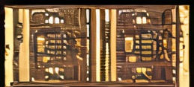

Slide 48
ML Visuals
By dair.ai
https://github.com/dair-ai/ml-visuals
Notes:
IMPORTANT NOTE: Please don’t request editing permission if you do not plan to add anything to the slides. If you want to edit the slides for your own purposes, just make a copy of the slides.
ML Visuals is a new collaborative effort to help the machine learning community in improving science communication by using more professional, compelling and adequate visuals and figures. You are free to use the visuals in your presentations or blog posts. You don’t need to ask permission to use any of the visuals but it will be nice if you can provide credit to the designer/author (author information found in the slide notes).
This is a project made by the dair.ai community and maintained in this GitHub repo. Our community members will continue to add more common figures and basic elements in upcoming versions. Think of this as free and open artefacts and templates which you can freely and easily download, copy, distribute, reuse and customize to your own needs. I am maintaining this set of slides on a bi-weekly basis where I will regularly organize and keep the slides clean from spam or unfinished content.
Contributing: To add your own custom figures, simply add a new slide and reuse any of the basic visual components (remember to request edit permissions). We encourage authors/designers to add their visuals here and allow others to reuse them. Make sure to include your author information (in the notes section of the slide) so that others can provide the proper credit if they use the visuals elsewhere (e.g. blog/presentations). Add your name and email just in case someone has any questions related to the figures you added. Also, provide a short description of your visual to help the user understand what it is about and how they can use it. If you need "Edit" permission, just click on the "request edit access" option under the "view only" toolbar above or send me an email at ellfae@gmail.com. If you have editing rights, please make sure not to delete any of the work that other authors have added. You can try to improve it by creating a new slide and adding that improved version (that’s actually encouraged).
Downloading a figure from any of the slides is easy. Just click on File→Download→(choose your format).
If you need help with customizing a figure or have an idea of something that could be valuable to others, we can help. Just open an issue here and we will do our best to come up with the visual. Thanks.

Slide 49
Basic ML Visuals
Notes:
Note:
Basic components go here.

Slide 50
Notes:
Note:
This is a simple round rectangle that can represent some process, operation, or transformation
Author: Elvis Saravia (ellfae@gmail.com)

Slide 51
Notes:
Note:
This can be used to represent a vector. If you want to edit the distance between each element, you can “ungroup” the shapes and then modify the distance between the individual lines.
Author: Elvis Saravia (ellfae@gmail.com)

Slide 52
Notes:
Symbolizing an embedding

Slide 53
Notes:
Note:
Can represent a neuron or some arbitrary operation
Author: Elvis Saravia (ellfae@gmail.com)

Slide 54
Notes:
Note:
These visuals can represent a multi-directional array (3D) input, tensor, etc.
Author: Elvis Saravia (ellfae@gmail.com)

Slide 55



Softmax
Convolve
Sharpen
Notes:
Note:
These visuals could represent transformations (left) or operations (right)
The visuals on the right use the Math Equations Add on for Google Slides.
If you click on the equation you are able to modify it by:
Selecting Add Ons → Math Equations → Menu
While the equation is selected, click “Connect to Equation” on the “Math Equations UI”
Then change the properties like color, size, etc.
Author: Elvis Saravia (ellfae@gmail.com)

Slide 56




Softmax
Convolve
Sharpen
Notes:
Note:
These visuals could represent transformations (left) or operations (right)
The visuals on the right use the Math Equations Add on for Google Slides.
If you click on the equation you are able to modify it by:
Selecting Add Ons → Math Equations → Menu
While the equation is selected, click “Connect to Equation” on the “Math Equations UI”
Then change the properties like color, size, etc.
Author: Elvis Saravia (ellfae@gmail.com)
Log:
Added a dark theme version of the previous slide

Slide 57
Softmax
Linear
Add & Norm
Feed
Forward
Add & Norm
Add & Norm
Feed
Forward
Multi-Head
Attention
Add & Norm
Add & Norm
Multi-Head
Attention
Masked
Multi-Head
Attention
Positional
Encoding
Positional
Encoding
Input
Embedding
Output
Embedding
Inputs
Outputs(shifted right)
Notes:
Note:
Using the same visual components from before and a few new custom ones, I was able to come up with the Transformer architecture
This is a reproduction of the Transformer architecture figure presented in the work of Vaswani et al. 2017
You can further customize it however you want
Author: Elvis Saravia (ellfae@gmail.com)

Slide 58
Softmax
Linear
Add & Norm
Feed
Forward
Add & Norm
Add & Norm
Multi-Head
Attention
Feed
Forward
Add & Norm
Add & Norm
Masked
Multi-Head
Attention
Multi-Head
Attention
Positional
Encoding
Positional
Encoding
Input
Embedding
Output
Embedding
Inputs
Outputs (shifted right)
Notes:
Note:
Using the same visual components from before and a few new custom ones, I was able to come up with the Transformer architecture
This is a reproduction of the Transformer architecture figure presented in the work of Vaswani et al. 2017
You can further customize it however you want
Author: Elvis Saravia (ellfae@gmail.com)

Slide 59
I
love
coding
and
writing
Tokenize
“I love coding and writing”
Notes:
Note:
This figure aims to demonstrate the process of tokenization
If you want to change the gradient colors of this shape, you can simply click on the shape and then select “Fill color” (the bucket looking icon at the top).
This is a gradient color so you can customize however you want
Author: Elvis Saravia (ellfae@gmail.com)

Slide 60
Hidden Layers
Input Layer
a^{[2]}₁
a^{[3]}₁
Output Layer
a^{[2]}₂
a^{[3]}₂
a^{[4]}
Ŷ
X
a^{[2]}₃
a^{[3]}₃
a^{[1]}_{n}
a^{[2]}_{n}
a^{[3]}_{n}
X = A^{[0]}
A^{[1]}
A^{[2]}
A^{[3]}
A^{[4]}
Notes:
Created By @srvmshr
sourav@yahoo.com

Slide 61
Hidden Layers
Input Layer
a^{[1]}₁
a^{[2]}₁
a^{[3]}₁
Output Layer
a^{[1]}₂
a^{[2]}₂
a^{[3]}₂
a^{[4]}
Ŷ
X
a^{[1]}₃
a^{[2]}₃
a^{[3]}₃
a^{[1]}_{n}
a^{[2]}_{n}
a^{[3]}_{n}
X = A^{[0]}
A^{[4]}
A^{[1]}
A^{[2]}
A^{[3]}
Notes:
Original by @srvmshr
sourav@yahoo.com
Dark themed version by (Elvis Saravia - ellfae@gmail.com)

Slide 62
Hidden Layers
Input Layer
^{[1}a]₁
a^{[2]}₁
a^{[3]}₁
Output Layer
a^{[1]}₂
a^{[2]}₂
a^{[3]}₂
a^{[4]}
Ŷ
X
a^{[1]}₃
a^{[2]}₃
a^{[3]}₃
a^{[1]}_{n}
a^{[2]}_{n}
a^{[3]}_{n}
X = A^{[0]}
A^{[1]}
A^{[2]}
A^{[3]}
A^{[4]}
Notes:
Created By @srvmshr
sourav@yahoo.com

Slide 63
CONV operation
MxM
ReLU
+b1
+b1
MxMX2
+b2
+b2
NxNx3
MxM
ReLU
a^{[l-1]}
a^{[l]}
Notes:
Added by @srvmshr
Sourav @ yahoo.com

Slide 64
CONV operation
MxM
ReLU
+b1
+b1
MxMX2
+b2
+b2
NxNx3
MxM
ReLU
Notes:
Added by @srvmshr
Sourav @ yahoo.com

Slide 65
CONV operation
MxM
ReLU
+b1
+b1
MxMX2
+b2
+b2
NxNx3
MxM
ReLU
Notes:
Added by @srvmshr
Sourav @ yahoo.com

Slide 66
Abstract backgrounds
Notes:
Note:
You can add abstract backgrounds here

Slide 67
Notes:
Note:
You can change the gradient of each component
Author: Elvis Saravia

Slide 68
DAIR.AI
Notes:
Note:
This is the header I use for the dair.ai NLP Newsletter
You can change the gradient of each component
You can customize the background as well by right clicking and changing to another gradient or static color
Author: Elvis Saravia

Slide 69
Notes:
Note:
This is the header I use for the dair.ai NLP Newsletter
You can change the gradient of each component
Author: Elvis Saravia

Slide 70
Notes:
Note:
This is the header I use for the dair.ai NLP Newsletter
You can change the gradient of each component
Author: Elvis Saravia

Slide 71
Gradient Backgrounds
Notes:
Note:
Gradient background shows some inspirations and ideas for color themes that could be used for backgrounds
The examples used in this section are inspired by https://uigradients.com

Slide 75
Community Contributions
Notes:
Note:
You can add abstract backgrounds here

Slide 76
Striding in CONV
S=1
S=2
Notes:
Created by @srvmshr
Sourav @ yahoo.com

Slide 77
Notes:
Created by @srvmshr
Sourav @ yahoo.com

Slide 79
MaxPool Same s=1
Inception Module
5x5 Same
3x3 Same
NxNx192
1x1 Same
NxNx192
NxNx128
NxNx32
NxNx64
Notes:
Created by @srvmshr
Sourav @ yahoo.com

Slide 80
t-1
t
Retraining w/o expansion
Notes:
Note:
1 hidden layer neural network
Author: Elvis Saravia (ellfae@gmail.com)

Slide 81
No-Retraining w/ expansion
Partial Retraining w/ expansion
Notes:
Note:
1 hidden layer neural network
Author: Elvis Saravia (ellfae@gmail.com)

Slide 82
t-1
t
t-1
t
No-Retraining w/ expansion
Partial Retraining w/ expansion
Notes:
Note:
1 hidden layer neural network
Author: Elvis Saravia (ellfae@gmail.com)

Slide 83
t-1
t
t-1
t
t-1
t
Retraining expansion
No-Retraining expansion
Partial Retraining expansion
Notes:
Note:
1 hidden layer neural network
Author: Elvis Saravia (ellfae@gmail.com)

Slide 84
Size
Family?
X
Y
#bed
Walk?
PRICE ŷ
Basic Neuron Model
ZIP
School
How does NN work (Insprired from Coursera)
Wealth
Ŷ = 0
X
Logistic Regression
Ŷ = 1
Notes:
By @srvmshr
sourav@yahoo.com

Slide 85
Linear regression
ReLU(x)
$
$
Size
Size
Notes:
By @srvmshr
sourav@yahoo.com

Slide 86
Training
CONV
3
CONV
1
CONV
2
CONV
5
CONV
6
CONV
7
I
I1
CONV
4
128*128*1
128*128*1
Encoder
Decoder
Decoder
V1
V
ENcoder
128*128*1
128*128*1
Notes:
By @srvmshr
sourav@yahoo.com

Slide 87
Large NN
Med NN
η
Small NN
SVM,LR etc
Amount of Data
Why does Deep learning work?
Notes:
By @srvmshr
sourav@yahoo.com

Slide 88
Hidden
Input
Output
a^{[1]}₁
a^{[1]}₂
One hidden layer neural network
X
a^{[2]}
Ŷ
a^{[1]}₃
a^{[1]}₄
X = A^{[0]}
A^{[1]}
A^{[2]}
Notes:
By @srvmshr
sourav@yahoo.com

Slide 89
a^{[1]}₁
x_{[1]}
a^{[2]}
a^{[1]}₂
x_{[2]}
x_{[1]}
x_{[2]}
x_{[3]}
Neural network templates
Notes:
By @srvmshr
sourav@yahoo.com

Slide 90
a^{[1]}₁
x_{[1]}
a^{[2]}
a^{[1]}₂
x_{[2]}
x_{[1]}
x_{[2]}
x_{[3]}
Neural network templates
Notes:
By @srvmshr
sourav@yahoo.com

Slide 91
Train
Valid
Test
Underfitting
Good fit
Overfitting
x2
x2
x2
x1
x1
x1
Train-Dev-Test vs. Model fitting
Notes:
By @srvmshr
sourav@yahoo.com

Slide 92
x_{[1]}
x_{[2]}
a_{[L]}
DropOut
x_{[3]}
x2
r=1
x2
Normalization
x1
x1
Notes:
By @srvmshr
sourav@yahoo.com

Slide 93
J
w2
Early stopping
Err
w1
w1
w2
Before Normalization
Dev
Train
it.
J
w2
w1
w1
After Normalization
w2
Notes:
By @srvmshr
sourav@yahoo.com

Slide 94
x₁
x₂
w[L]
w[1]
w[2]
w[L-2]
w[L-1]
Deep neural networks
FN
TN
TP
FP
Understanding
Precision & Recall
Notes:
By @srvmshr
sourav@yahoo.com

Slide 95
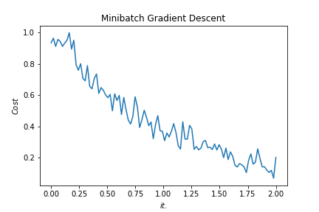
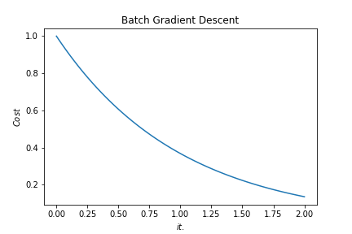
Batch vs. Mini-batch Gradient Descent
w2
w2
BGD
SGD
Batch Gradient Descent vs. SGD
SGD
w1
w1
Notes:
By @srvmshr
sourav@yahoo.com

Slide 96
x_{[1]}
p_{[1]}
x_{[2]}
p_{[2]}
x_{[3]}
Softmax Prediction with 2 outputs
Notes:
By @srvmshr
sourav@yahoo.com

Slide 97
Miscellaneous

Slide 98
16
16+32
16
16
1
3
Convolution 3x3
Convolution 1x1
Dropout 0.1
16
Max Pooling 2x2
Skip connection
Dropout 0.2
Up Sampling 2x2
Block copied
Dropout 0.3
32
32
32+64
32
64
64
64+128
64
128
128
128+256
128
256
256
Notes:
By @avsthiago

Slide 99
Layer1
Layer2
Layer3
Input
Output
Conv3-32
Conv3-32
Conv3-32
Conv3-32
Max-Pool
Conv3-64
Max-Pool
Conv3-128
Max-Pool
Conv3-64
FC-512
Softmax
FC
Layer4
FC
Layer3
Max-Pool
Layer1
Layer2
Layer3
Layer4
Conv
Layer2
Max-Pool
Conv3-32
Output
Conv3-32
Conv3-32
Conv3-32
Max-Pool
Conv3-64
Max-Pool
Conv3-128
Max-Pool
Conv3-64
FC-512
Conv
Layer1
Input
Notes:
By @avsthiago

Slide 100
Filter concatenation
3x3 convolutions
5x5 convolutions
1x1 convolutions
1x1 convolutions
1x1 convolutions
1x1 convolutions
3x3 max pooling
Previous layer
Notes:
By @avsthiago

Slide 101
Previous layer
1x3 conv,
1 padding
1x3 conv,
1 padding
1x7 conv,
3 padding
1x3 conv,
1 padding
1x5 conv,
2 padding
1x3 conv,
1 padding
Filter concatenation

Slide 102
Avg-Pool
Auxiliary Classifier
Conv
FC
FC
Softmax
Inception
Input
Inception
Conv
Max-Pool
Conv
Max-Pool
Conv
Max-Pool
Inception
Inception
Max-Pool
Inception
Inception
Inception
Inception
Inception
Max-Pool
Avg-Pool
Conv
FC
Softmax
Avg-Pool
Auxiliary Classifier
Conv
FC
FC
Softmax
Input
ConvTranspose2d
Max-Pool
Conv
Max-Pool
Notes:
By @avsthiago

Slide 103
Filter concatenation
Filter concatenation
3x3 conv.
1x3 conv.
3x1 conv.
1x1 conv.
3x3 conv.
3x3 conv.
1x1 conv.
1x3 conv.
3x1 conv.
3x3 conv.
1x1 conv.
1x1 conv.
Pool
1x1 conv.
1x1 conv.
Pool
1x1 conv.
1x1 conv.
Previous layer
Previous layer
(a)
(b)
Notes:
By @avsthiago

Slide 104
Previous input
Previous input
x
x
F(x)
F(x)
Stacked layers
Stacked layers
x
identity
+
y=F(x)
y=F(x)+x
R1
R1
R2
R1
R1
R2
R3
R1
R2
R3
Notes:
By @avsthiago

Slide 105
Dense Block 1
Dense Block 2
Dense Block 3
Softmax
FC
Avg-Pool
Avg-Pool
Conv
Conv
Input
Avg-Pool
Conv
Transition layers
Notes:
By @avsthiago

Slide 106
h_{i+1}
Filter concatenation
h_{i+1}
add
add
Filter concatenation
3x3 max
3x3 conv
3x3 avg
identity
add
add
add
add
add
add
add
add
3x3 conv
identity
3x3 conv
5x5 conv
3x3 avg
identity
3x3 avg
3x3 avg
3x3 conv
5x5 conv
7x7 conv
5x5 conv
3x3 max
7x7 conv
3x3 avg
5x5 conv
h_{i}
h_{i}
...
...
h_{i-1}
h_{i-1}
(a)
(b)
Notes:
By @avsthiago

Slide 107

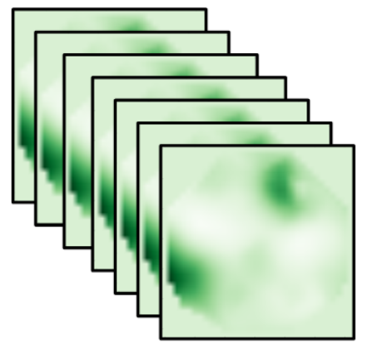
=
14*14
28*28
56*56
112*112
224*224
Notes:
By @avsthiago

Slide 108
Notes:
By @avsthiago
Dark-theme version of the previous (by Elvis Saravia)

Slide 109
Max(1,1,5,6) = 6
Y
1
1
2
4
5
6
7
8
6
8
3
2
1
0
Pooling performed with a 2x2 kernel and a stride of 2
3
4
1
2
3
4
X
Image Representation
Notes:
By @avsthiago

